Slide 1
Videos to set up
Jack Andraka http://safeshare.tv/w/rzYTPnXjGU (first 50 secs)
Tour de France https://www.youtube.com/watch?v=Zzjv1XpGJnc (first 2 minutes)
Panyee FC https://www.youtube.com/watch?v=jU4oA3kkAWU (all 5 minutes)
Countdown: http://itsalmo.st/#summer_52enr
Notes:
This presentation by @TeacherToolkit ( Ross Morrison McGill ) and is licensed under a Creative Commons Attribution-NonCommercial-NoDerivs 3.0 Unported License. Based on all work published at www.teachertoolkit.me
@TeacherToolkit Limited.
License:
You are free to:
Share — copy and redistribute the material in any medium or format
The licensor cannot revoke these freedoms as long as you follow the license terms.
Under the following terms:
Attribution — You must give appropriate credit, provide a link to the license, and indicate if changes were made. You may do so in any reasonable manner, but not in any way that suggests the licensor endorses you or your use.
NonCommercial — You may not use the material for commercial purposes.
NoDerivatives — If you remix, transform, or build upon the material, you may not distribute the modified material.
No additional restrictions — You may not apply legal terms or technological measures that legally restrict others from doing anything the license permits.

Slide 2
Copyright Notice
This presentation by @TeacherToolkit ( Ross Morrison McGill ) and is licensed under a Creative Commons Attribution-NonCommercial-NoDerivs 3.0 Unported License. Based on all work published at www.teachertoolkit.me
@TeacherToolkit Limited.
License:
You are free to:
Share — copy and redistribute the material in any medium or format
The licensor cannot revoke these freedoms as long as you follow the license terms.
Under the following terms:
Attribution — You must give appropriate credit, provide a link to the license, and indicate if changes were made. You may do so in any reasonable manner, but not in any way that suggests the licensor endorses you or your use.
NonCommercial — You may not use the material for commercial purposes.
NoDerivatives — If you remix, transform, or build upon the material, you may not distribute the modified material.
No additional restrictions — You may not apply legal terms or technological measures that legally restrict others from doing anything the license permits.
Notes:
This presentation by @TeacherToolkit ( Ross Morrison McGill ) and is licensed under a Creative Commons Attribution-NonCommercial-NoDerivs 3.0 Unported License. Based on all work published at www.teachertoolkit.me
@TeacherToolkit Limited.
License:
You are free to:
Share — copy and redistribute the material in any medium or format
The licensor cannot revoke these freedoms as long as you follow the license terms.
Under the following terms:
Attribution — You must give appropriate credit, provide a link to the license, and indicate if changes were made. You may do so in any reasonable manner, but not in any way that suggests the licensor endorses you or your use.
NonCommercial — You may not use the material for commercial purposes.
NoDerivatives — If you remix, transform, or build upon the material, you may not distribute the modified material.
No additional restrictions — You may not apply legal terms or technological measures that legally restrict others from doing anything the license permits.

Slide 3
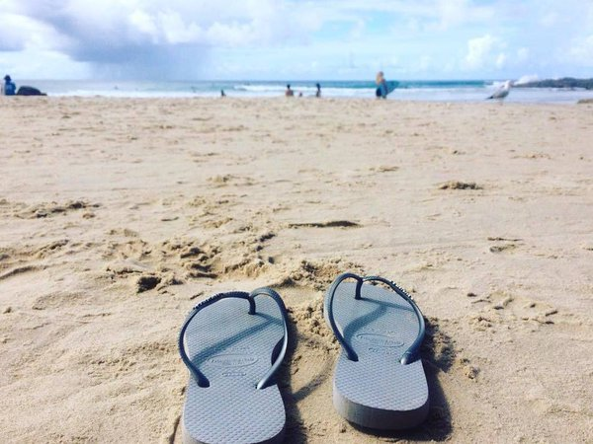
Thought of the week:
“Some of the best memories are made in flip flops.”
― Kellie Elmore

Slide 4
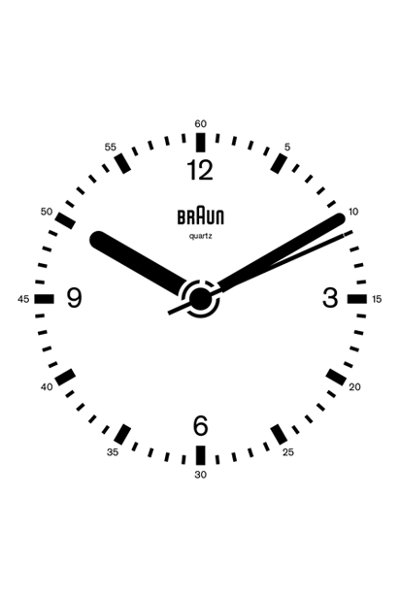
Time is ticking…

Slide 5
Memories and Time
What will you acheive this summer?
How will you use your time?
What memories will you gain from 2016?

Slide 6
It’s almost the end of term.
Notes:
Countdown: http://itsalmo.st/#summer_52enr

Slide 7
It’s almost the end of term.
But before we end the year, I would like to present
to you some statistics, facts and events.

Slide 8
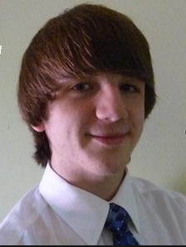
Meet Jack – your average student:
Born: 8 January 1997 (age 19)

Slide 9
So far, Jack – just like you, this academic year has:
38 weeks
190 Registrations with your Tutor
950 lessons
12.6 hours having ‘Break’
31.6 hours having ‘Lunch’

Slide 10
We will come back to Jack later…

Slide 11
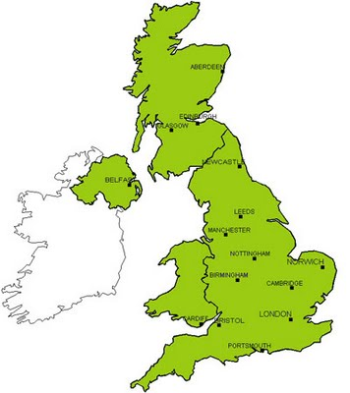
Facts: British population…
According to the 2011 census, the total population of the United Kingdom is around 63,182,000.
You would need to multiply
Quintin Kynaston … 52,651 times!

Slide 12
The average British person:
The United Kingdom has an extremely high literacy rate (99% at age 15 and above).
This means 631,820 people cannot read.

Slide 13
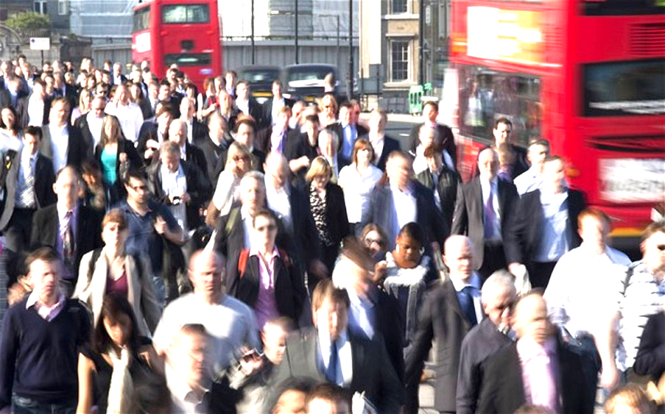
The average British person:
About 40% of British students go on to university.
Academic year All Students
2011/12 2,496,645
2010/11 2,501,295
2009/10 2,493,415

Slide 14
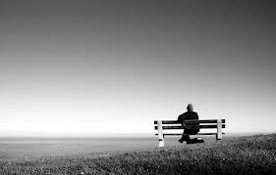
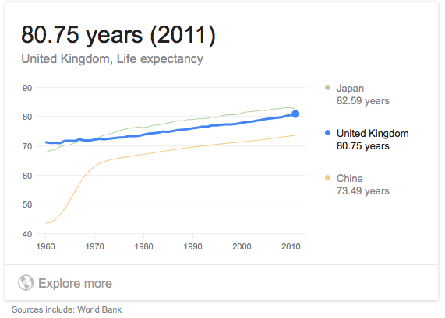
The average British person lives:

Slide 15
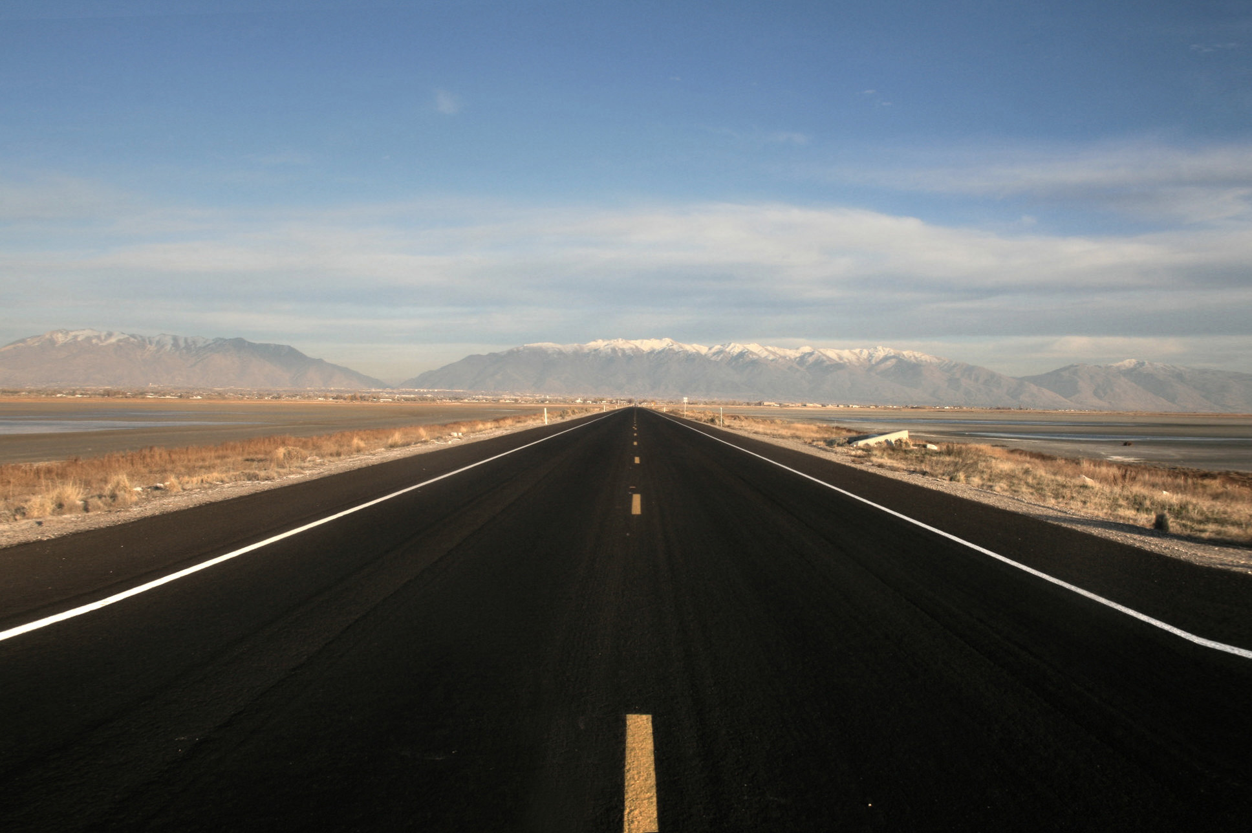
Between now and the age you leave school (at 18 years old): Year 9
From this week in July 2016 to, Friday, July 14, 2020
Result: 3 years, 24 days.
Alternative time units:
2,151,500 minutes
39,000 hours
1,494 days left at school.
213 weeks
without weekends = 1,036 days.
Notes:
Website used to calculate: http://www.timeanddate.com/date/durationresult.html?m1=7&d1=8&y1=2013&m2=7&d2=14&y2=2017

Slide 16
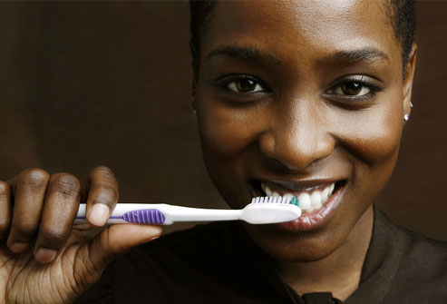
In a lifetime, it is predicted you will:
Spend 18 minutes every week cleaning their teeth.
This means you will brush your teeth for 1,248 hours.
This is 2 full months (24hrs) non-stop brushing.

Slide 17
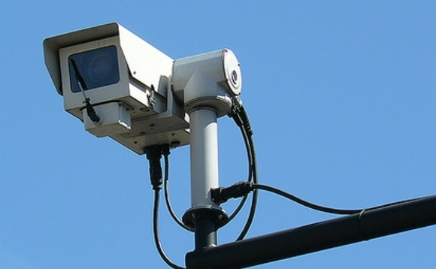
In a lifetime, it is predicted you will:
Be observed on
CCTV camera 300 times a day

Slide 18
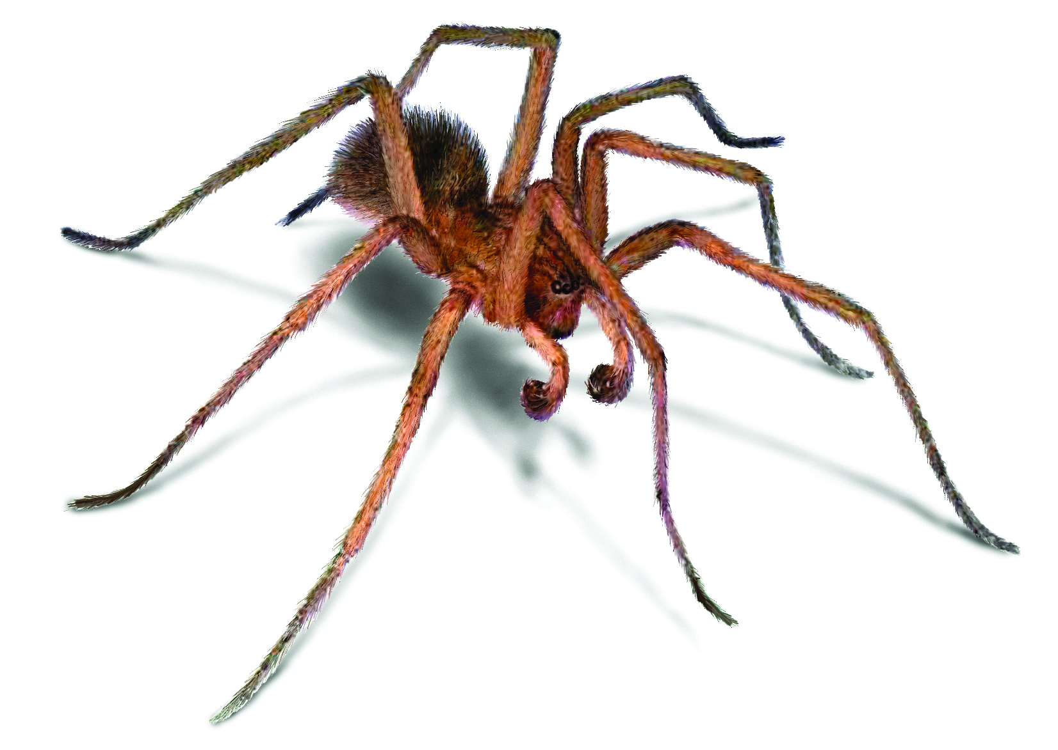
In a lifetime, it is predicted you will:
The average person swallows
8 spiders a year while asleep.”

Slide 19
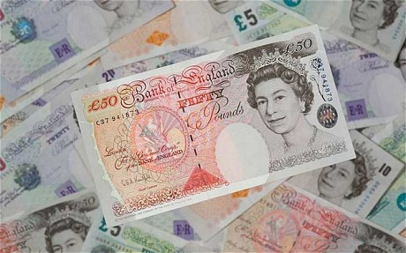
In a lifetime, it is predicted you will:
If you worked for 20 years, your average salary would be £39,000.
That’s approximately £1,560,000 in earnings over 40 years...

Slide 20
A once in a lifetime event:

Slide 21
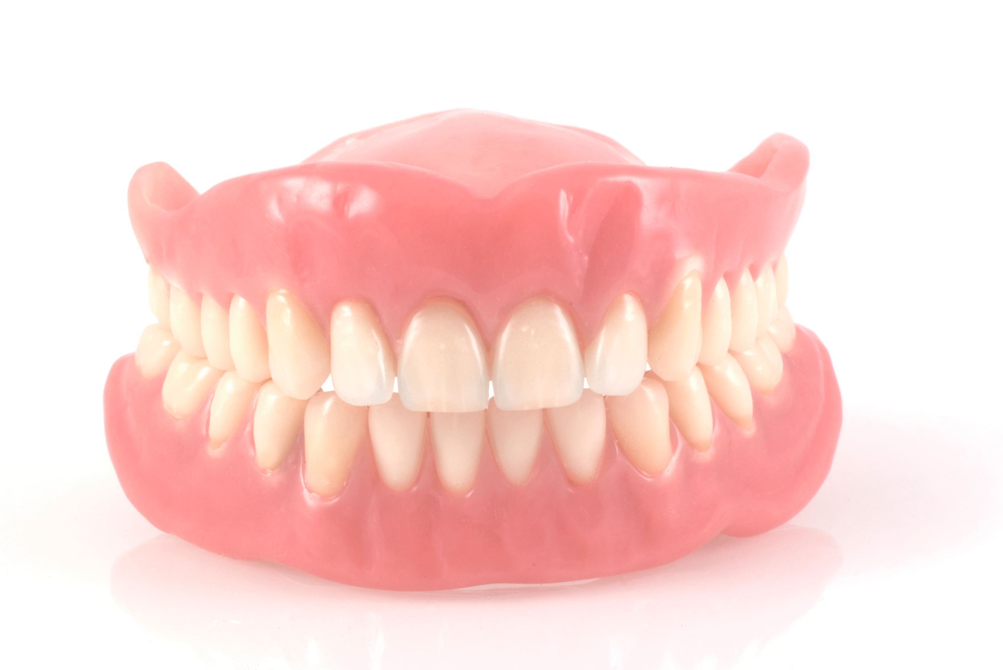
Grow a NEW set of adult teeth ...
Notes:
Queen’s jubilee – 60 years of reign

Slide 22
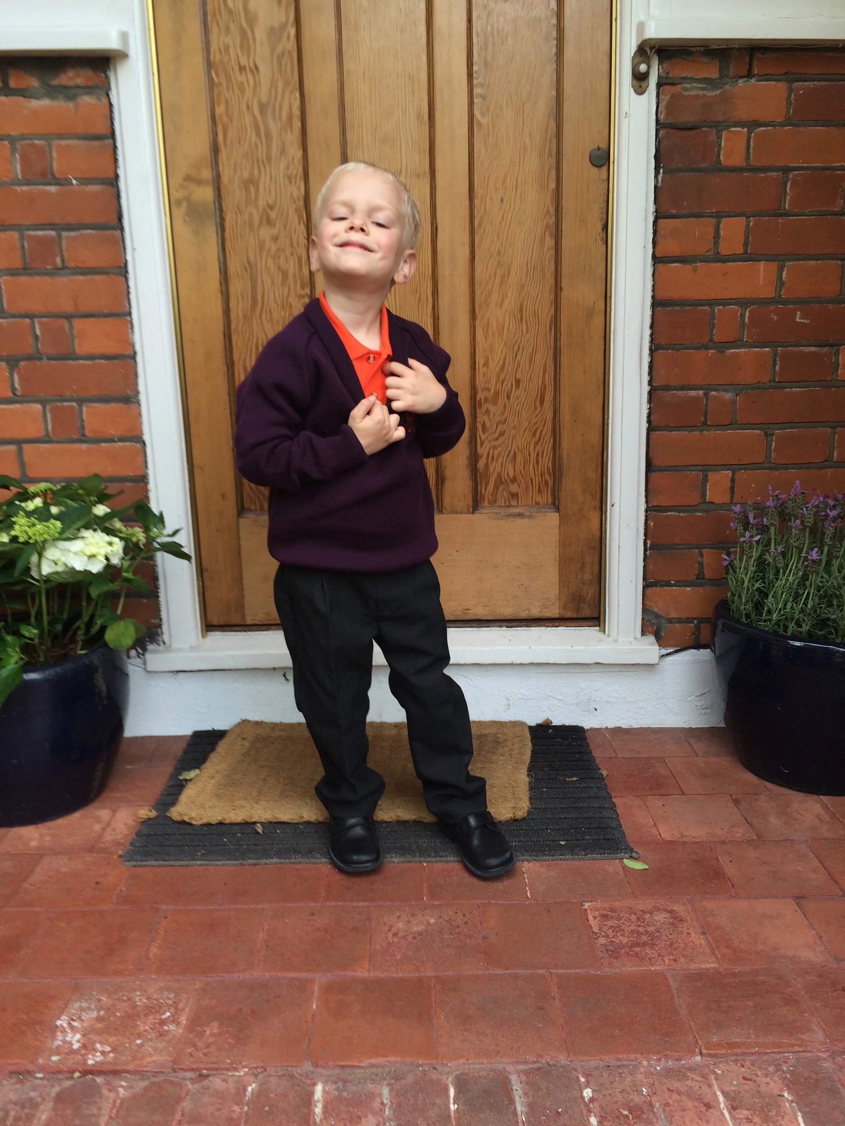
First day at school
Notes:
Queen’s jubilee – 60 years of reign

Slide 23
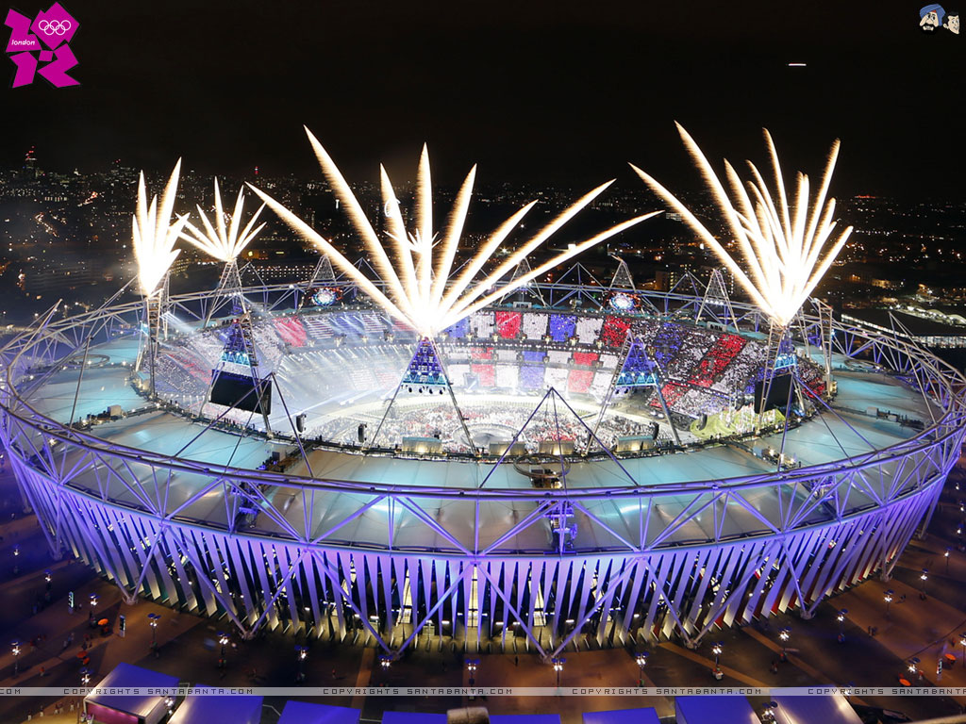
London Olympics 2012
Notes:
The London Olympics 2012….last held in 1908 and 1948

Slide 24
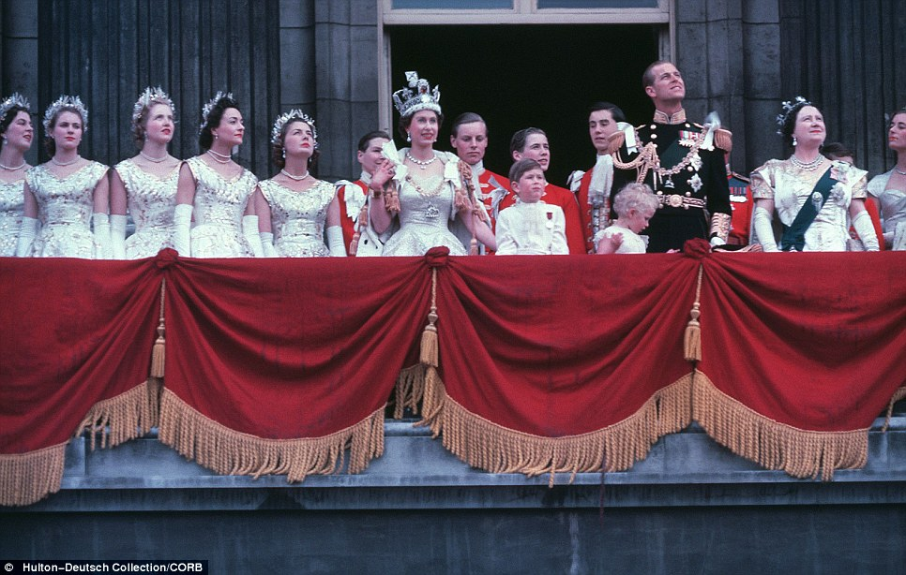
Queen’s Jubilee: 1952-2012
Notes:
Queen’s jubilee – 60 years of reign

Slide 25
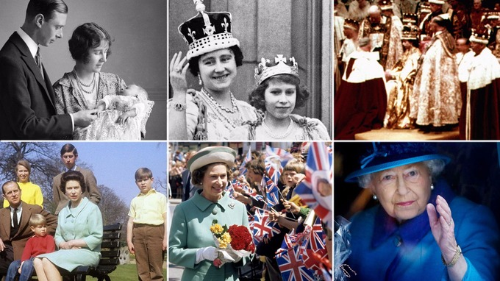
Queen - Aged 90 - 2016
Notes:
Queen’s jubilee – 60 years of reign

Slide 26
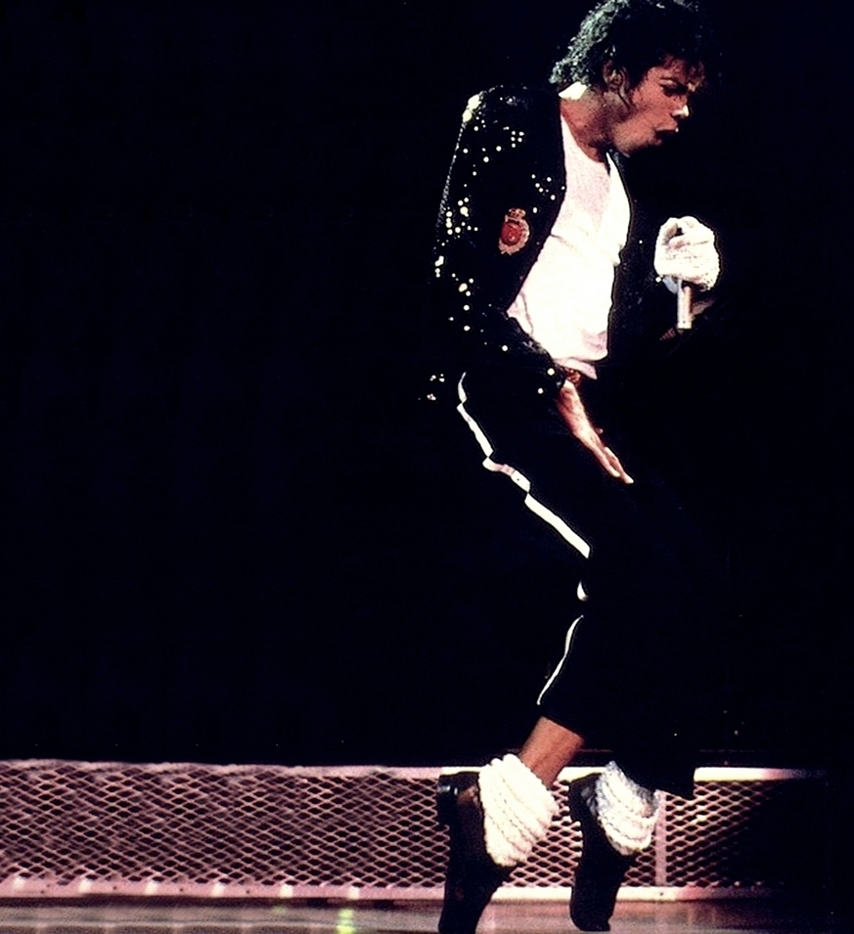
Iconic pop-stars
1958 - 2009
Notes:
Iconic pop stars who have lived and died.

Slide 27
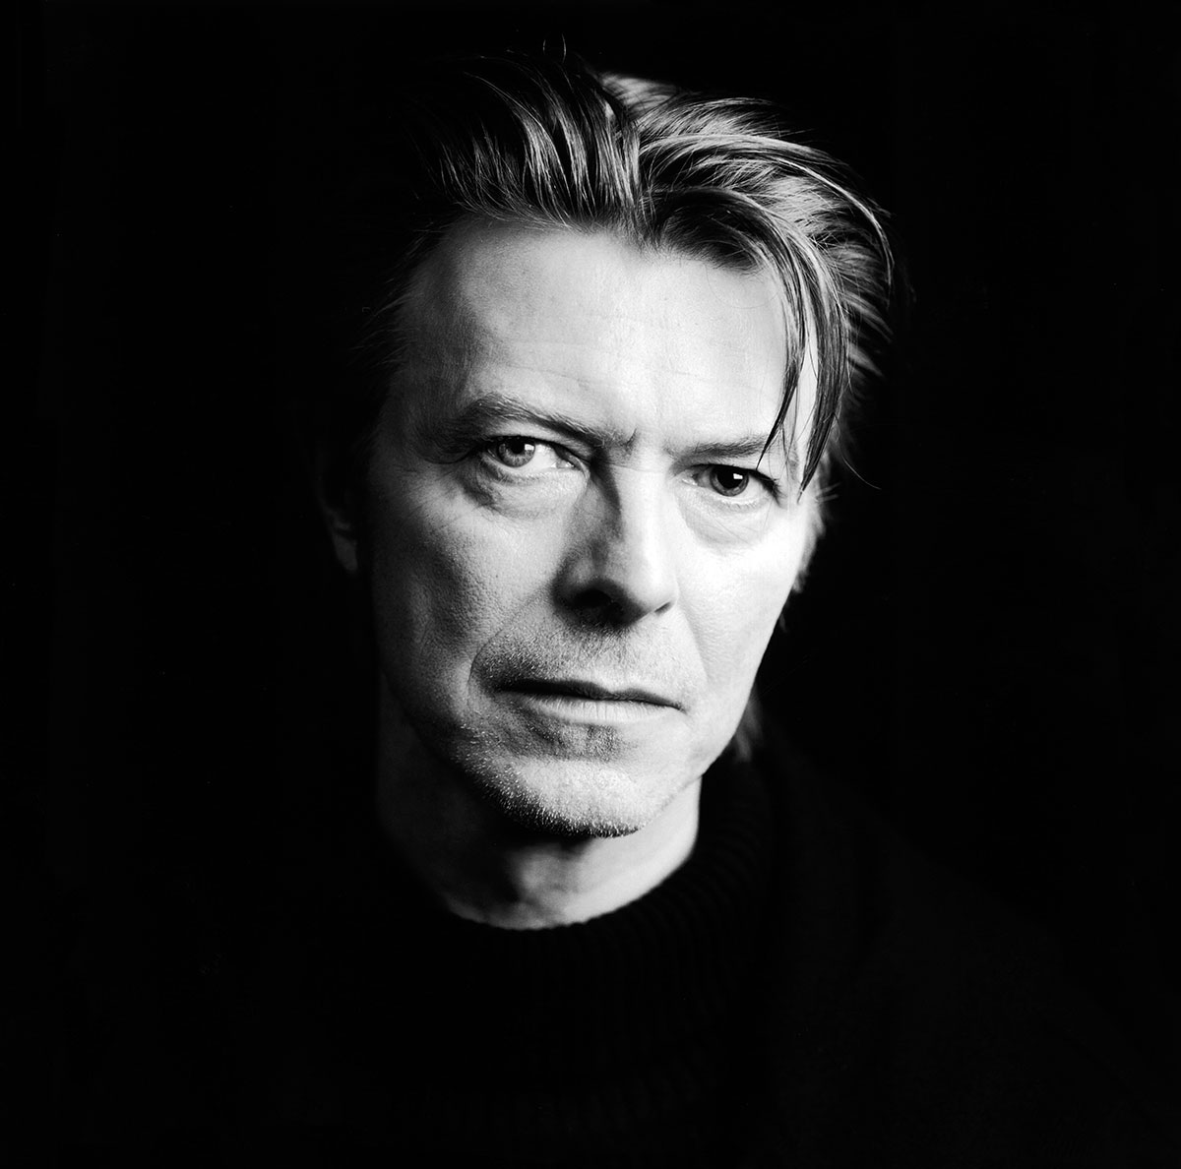
Iconic pop-stars
1947 - 2016
Notes:
Iconic pop stars who have lived and died.

Slide 28
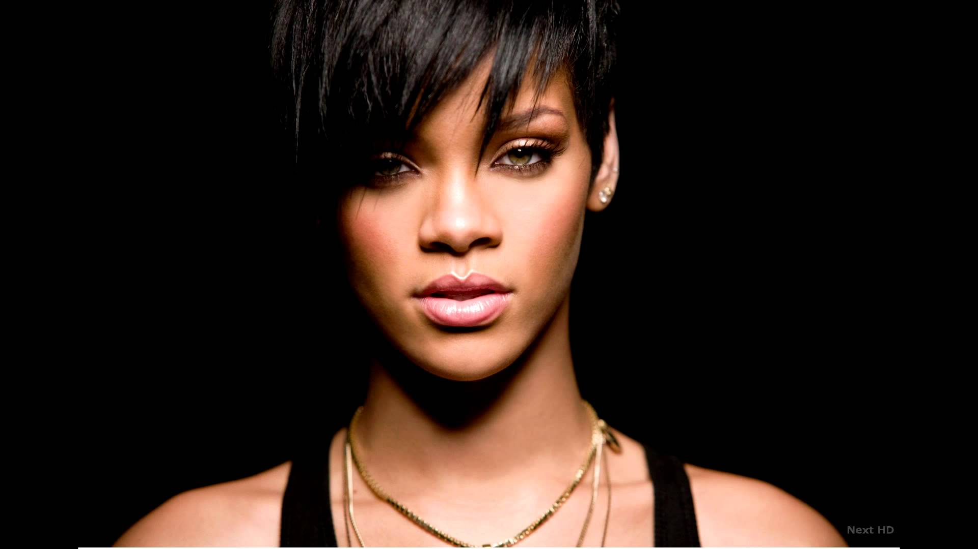
Who will be an icon in 30 years?
Notes:
Iconic pop stars who have lived and died.

Slide 29
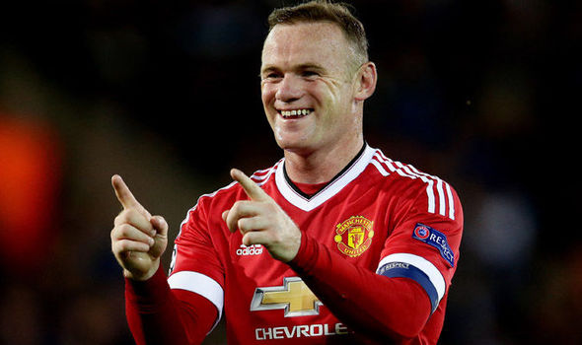
Who will be an icon in 30 years?
Notes:
Iconic pop stars who have lived and died.

Slide 30
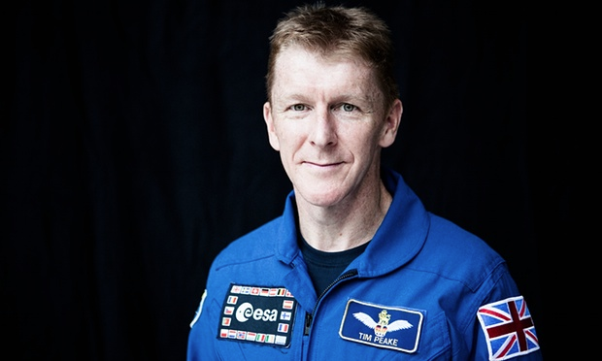
Who will be an icon in 30 years?
Notes:
Iconic pop stars who have lived and died.

Slide 31
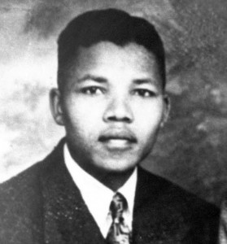
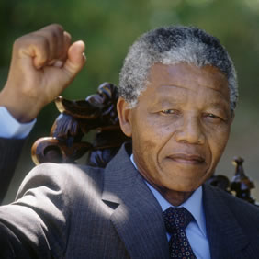
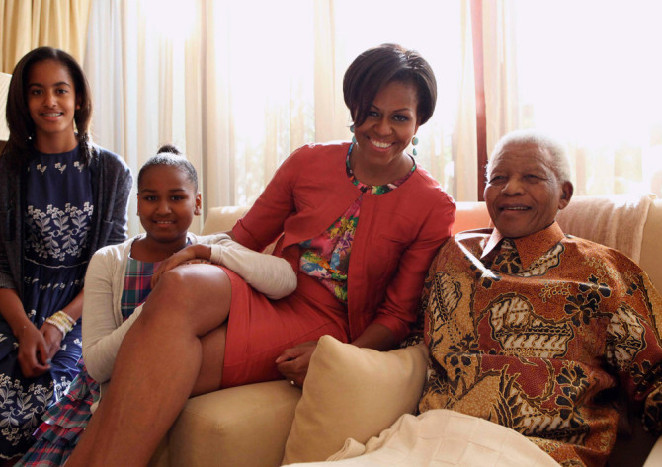
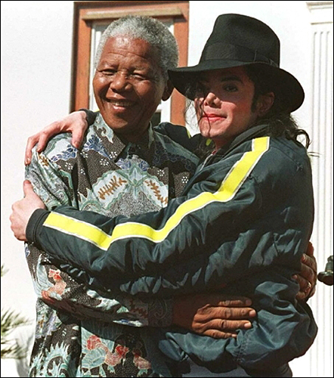
Amazing life stories
Notes:
Nelson Mandela

Slide 32
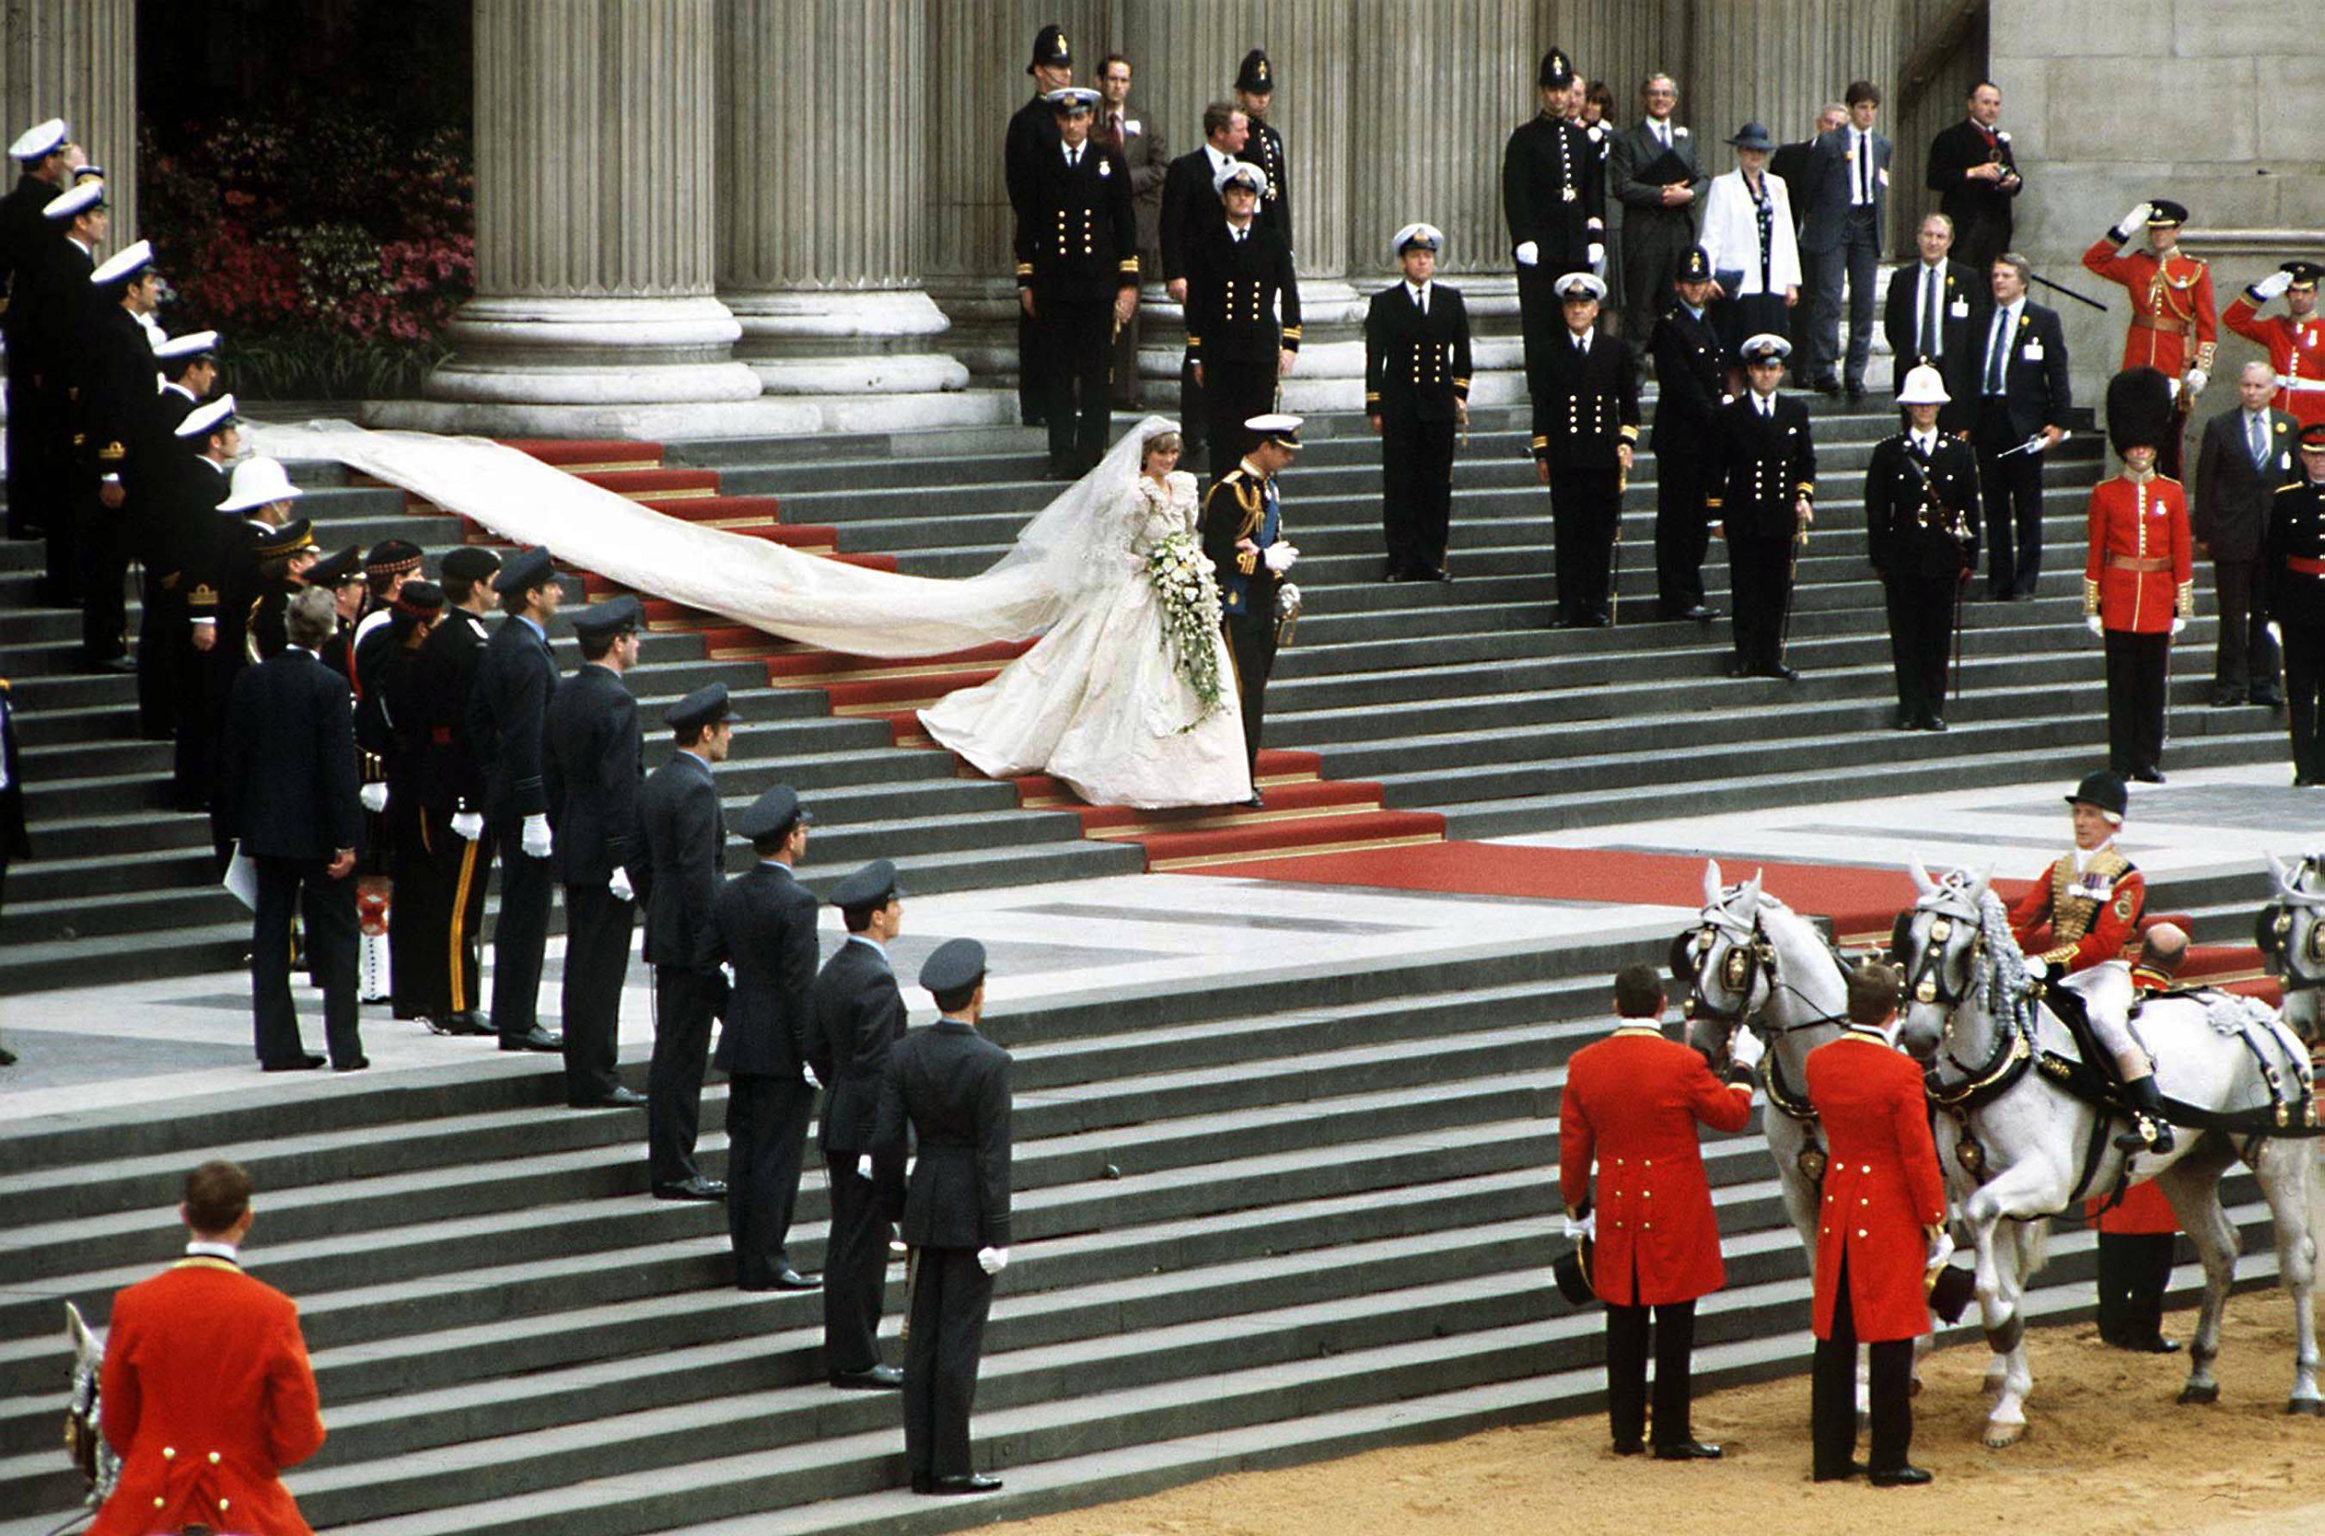
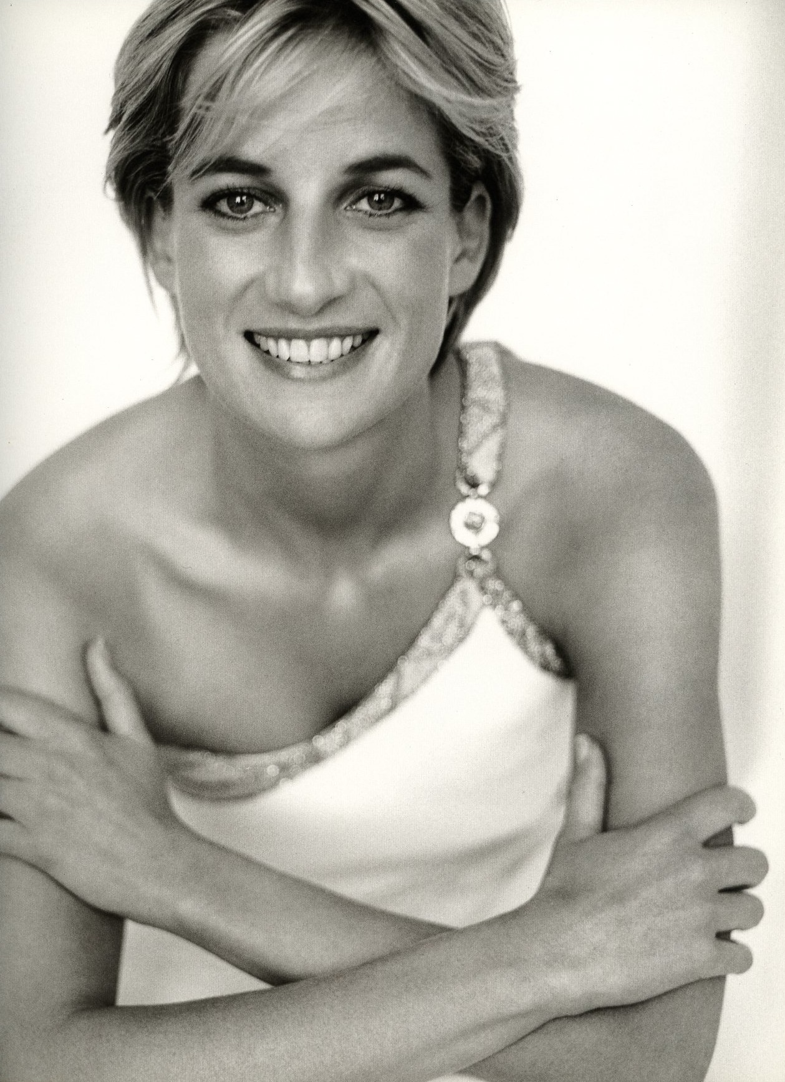
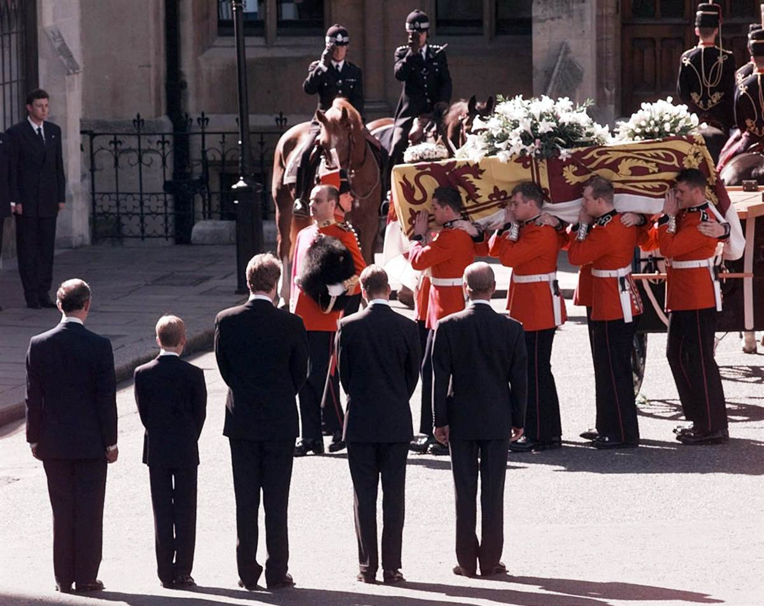
Amazing life stories
Notes:
Princess Diana – wedding and funeral.

Slide 33
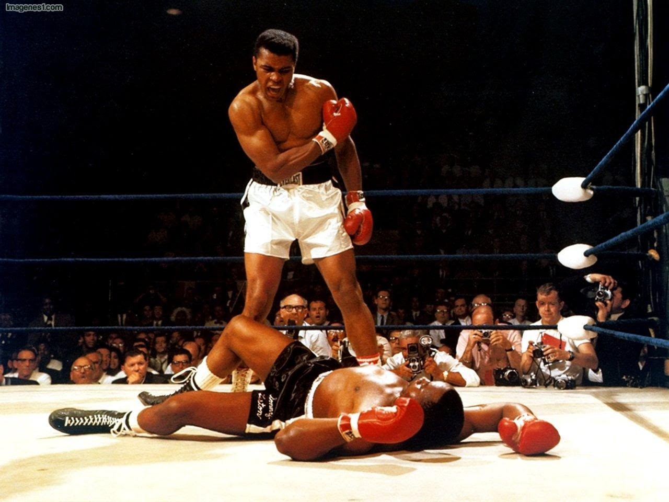
Muhammad Ali
1942 - 2016
I hated every minute of training, but I said, 'Don't quit. Suffer now and live the rest of your life as a champion.'
Notes:
Princess Diana – wedding and funeral.

Slide 34
Do you recognise this?
Notes:
Fred Perry logo

Slide 35
Do you recognise this?
Notes:
Fred Perry logo

Slide 36
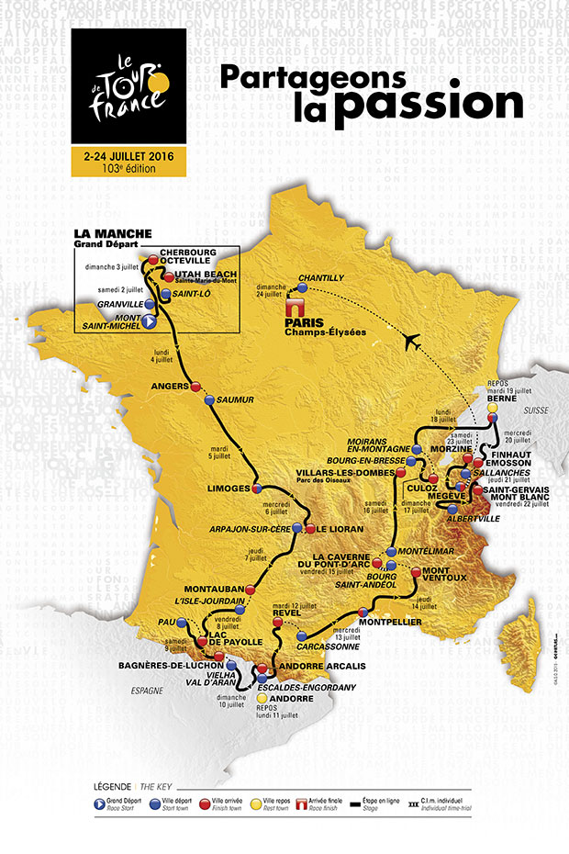
July 2016
103th Tour de France
21 stages and a distance of 3,519 kilometres.
9 flat stages
1 hilly stage
9 mountain stages
4 summit finishes
2 individual time trial stages
2 rest days
Greatest sporting event in the world
Notes:
Fred Perry – bio slides later

Slide 37
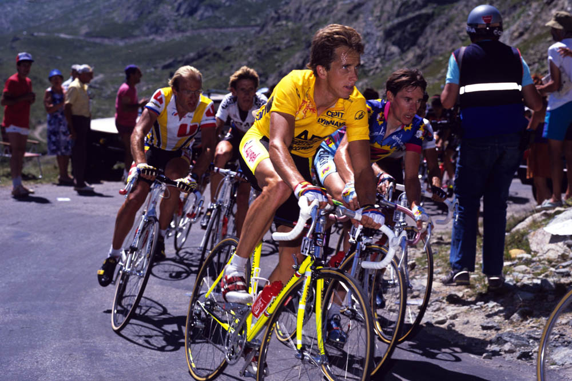
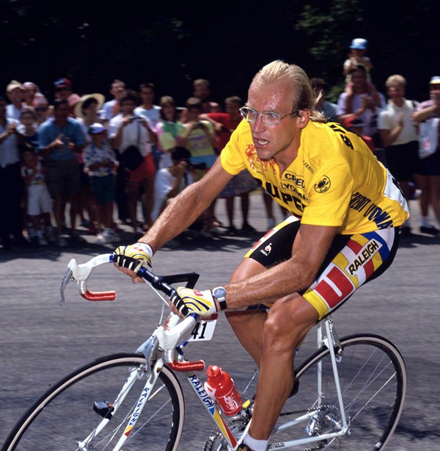
Tour de France memories/stories
Notes:
Fred Perry logo

Slide 38
After 2,000 miles …
link
Notes:
https://www.youtube.com/watch?v=Zzjv1XpGJnc - play to 2 minutes

Slide 39
Meet Jack – your average student:
Born: 8 January 1997 (age 19)

Slide 40
Jack – your average student:
This is Jack Andraka.
He is 19.
Just like you, he has spent the amount
of time same at school.
38 weeks
190 Registrations with your Tutor
950 lessons
12.6 hours having ‘Break’
31.6 hours having ‘Lunch’

Slide 41
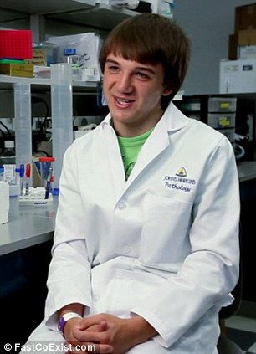
Jack Andraka – your average student:
Due to his love for Science:
He became an international sensation by inventing a cheap and accurate pancreatic cancer sensor.
He was just 15.

Slide 42
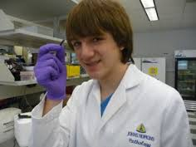
Remember the name: Jack Andraka
He wrote 200 letters to
college professors, before 1 person took him seriously.
His sensor has proved to be 99.9% accurate.
x28 faster. x28 less expensive
100+ times more sensitive than current tests.
Each test costs between 4-6 pence.

Slide 43
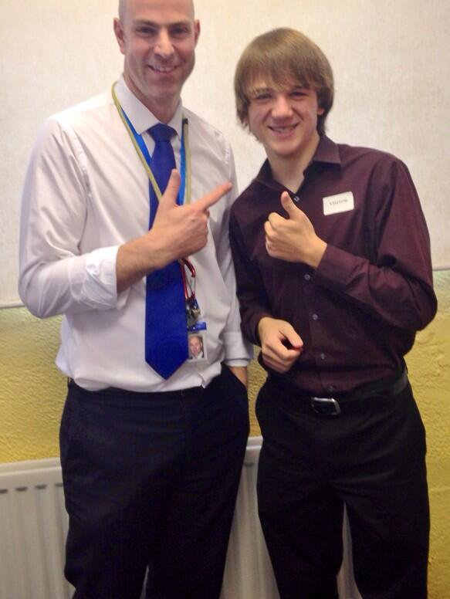
Remember the name: Jack Andraka
http://safeshare.tv/w/rzYTPnXjGU - play for 45secs
Notes:
https://www.youtube.com/watch?v=Nq4x8C6Dcf8
Jack Andraka video:
http://safeshare.tv/w/rzYTPnXjGU
Play for 45 secs before you and the audience get lost

Slide 44
It’s almost the end of term.
The reason I talk to you about “Memory and Time” is this…

Slide 45
It’s almost the end of term.
You have 6 weeks
ahead of you…

Slide 46
It’s almost the end of term.
42 days
1,000 hours
60,480 minutes

Slide 47
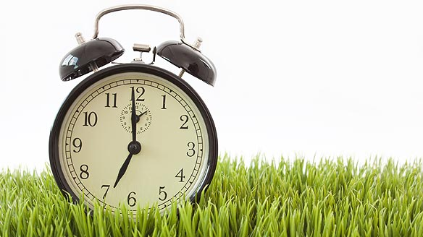
It’s almost the end of term.
What could you do with your time?
What memory could you create?

Slide 48
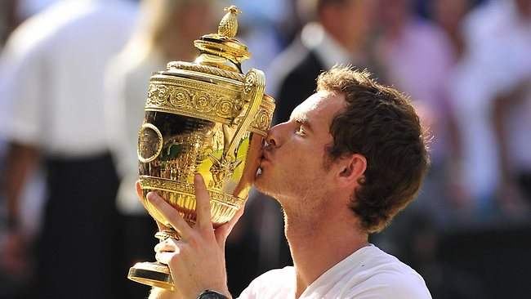
It’s almost the end of term.
What could you do in 3 hours?
The time it took Andy Murray to win Wimbledon…

Slide 49
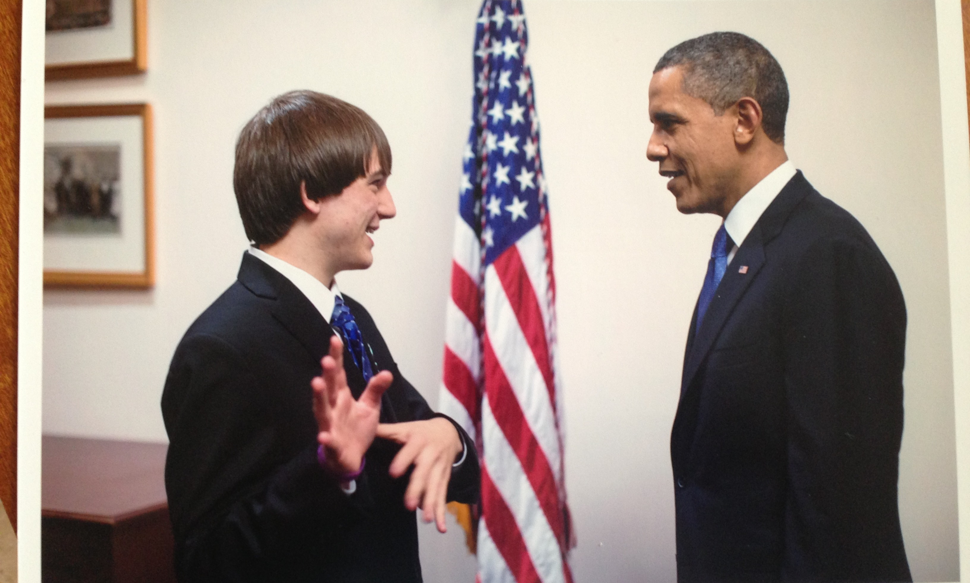
It’s almost the end of term.
What could you do in 1000 hours?
The time it took Jack to invent his test for cancer…
Notes:
This timing reference is a guess…

Slide 50
It’s almost the end of term.
This is the time you have…
42 days
1,000 hours
60,480 minutes
Use it wisely…

Slide 51
Learn a language?
Take up a new sport?
Read a book?
Work in the community?

Slide 52
Memories and Time
What will you acheive this summer?
How will you use your time?
What memories will you gain from 2016?

Slide 53
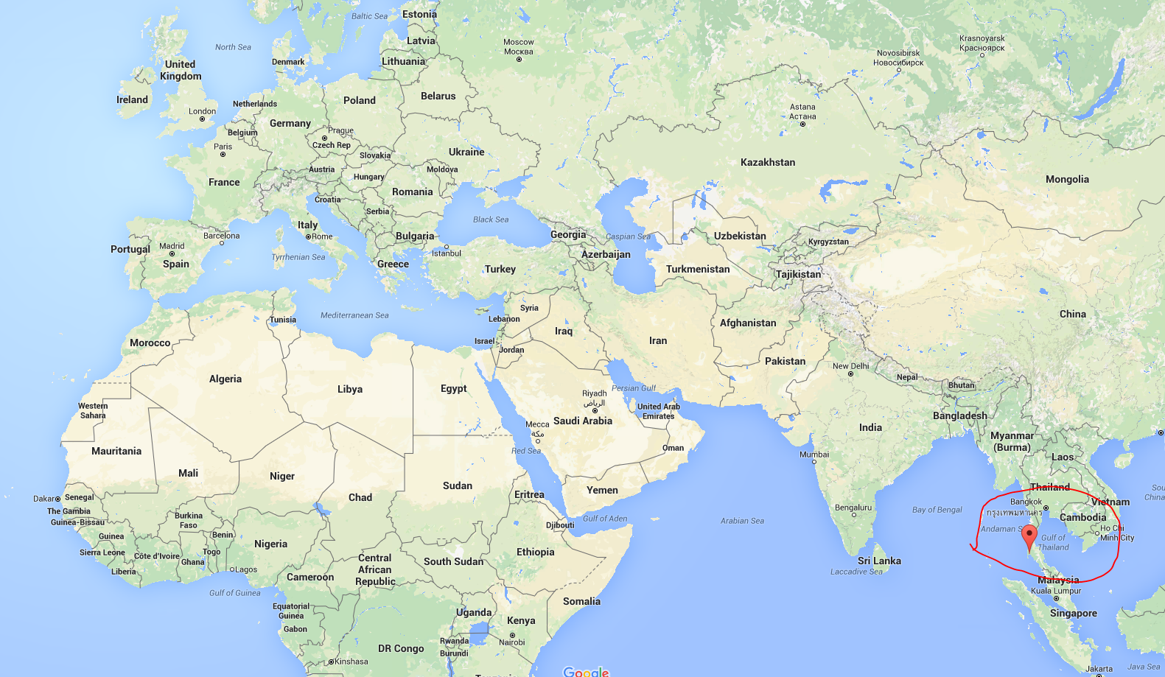
Panyee FC
(Football Club)
In 1986 a football team that lived on a little island in the south of Thailand called “Koh Panyee”.
It’s a floating village in the middle of the sea.
The kids loved to watch football but had nowhere to play or practice. But they didn’t let that stop them ...

Slide 54
A true story
Link
Notes:
https://www.youtube.com/watch?v=jU4oA3kkAWU

