Slide 1


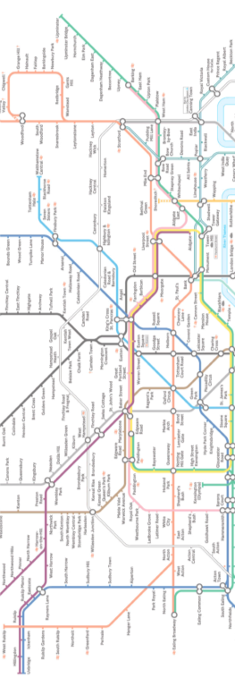
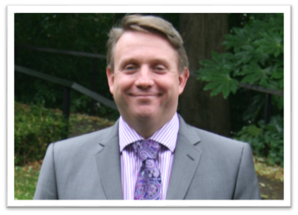


Welcome to
TeachMeet London
TeachMeet London
Alex Atherton
QK Headteacher

Slide 2
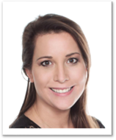
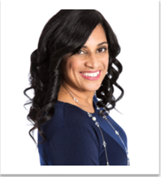
Welcome to
TeachMeet London
TeachMeet London
Emma Mulqueeny
Jaz Ampaw-Farr
Keynote
Keynote

Slide 3
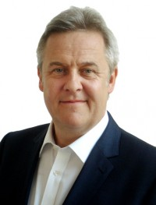


Welcome to
TeachMeet London
TeachMeet London
Question Time
Ty Goddard

Slide 4
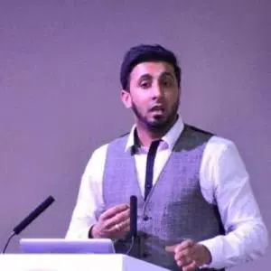
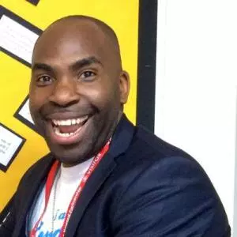
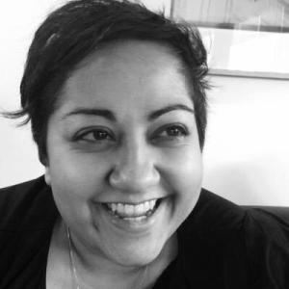
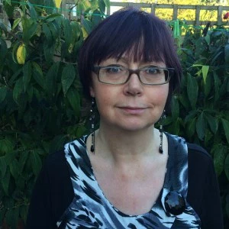
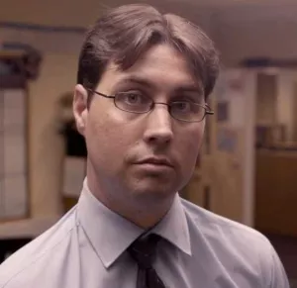
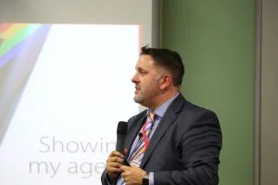
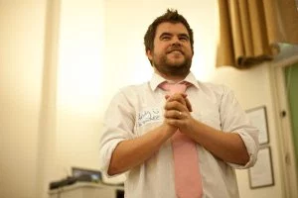
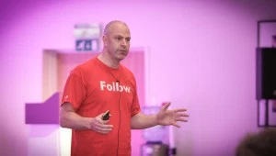
Welcome to TeachMeet London
HOSTS
TeachMeet London
@ASTSupportAAli | @ActionJackson | @BennieKara | @DiLeed
@ICTIvangelist | @ICTMagic | @iTeachRE | @TeacherToolkit
Notes:
Meet your hosts. Twitter ID

Slide 5


TeachMeet London
Wifi:QKP-Guest
Password: QKGuest1#
Hashtag:#TMLondon
TeachMeet London
Notes:
Wifi codes / tweets etc

Slide 6
TeachMeet London
AGENDA
FIRST HALF
SECOND HALF
TIME | ACTIVITY
6.00-6.05pm | Kick-Off / Introductions
6.05-6.20pm | Keynote
6.20-6.55 | Presentations
6.55-7.05pm | Question Time
7.05-7.25pm | Break (approx)
TIME | ACTIVITY
7.25-7.35pm | Question Time
7.35-7.45pm | Keynote
7.45-8.25pm | Presentations
8.25-8.30pm | Departure/ Thank yous
TeachMeet London

