Slide 1
The Queen and a Supermodel – oh… and me: Emma Mulqueeny @hubmum
Women in technology
2016

Slide 2
My career path
Learned to spell
Dad
Parliament and Rumplestiltskin
Government and Rewired/Young
Speaking at TEDx events and around the world

Slide 3
How to put women and girls off programming or coding for life, by Emma E Mulqueeny

Slide 4
Last year this woman had the most effect on my life as a female technologist
And on the lives of the YRSers

Slide 5
… and then I got an email

Slide 6
Natalia Vodianova
Russian super-model, co-founder of Elbi

Slide 7
And right now I do this
Elbi
Notes:
Elbi is a digital platform empowering people to be charitable every day. You can donate time, creativity or money and get feedback from those you help

Slide 8
That enables this
Loving the love button

Slide 9
And you know why this is important? Forget the supermodels for a mo…

Slide 10
Who wants their life defined by this dude?
He’s cross!

Slide 11
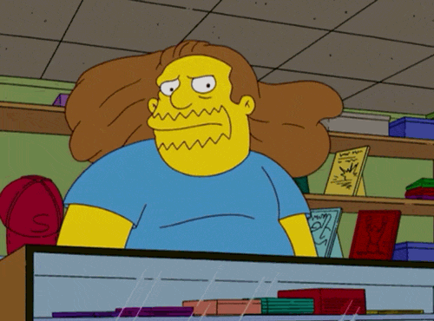

Slide 12
We need to encourage more of this…
Fashion, design and technology - profit with purpose - so go and invent something today that makes us all proud to be women in technology
Notes:
Candice

