Slide 1
#TeachMeet London 23rd March 2016 Jill Berry @jillberry102 Leadership transitions and how to make the most of them

Slide 2
Think about spheres of influence

Slide 3
What is your current sphere of influence? Do you have aspirations to expand it?

Slide 4
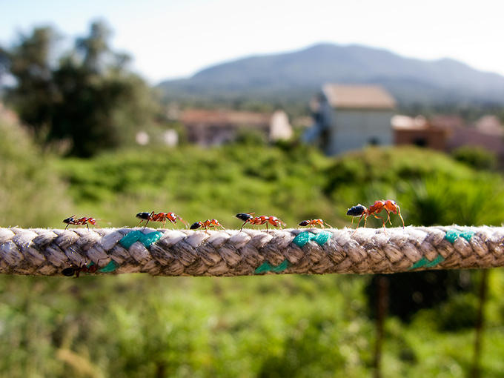

Slide 5
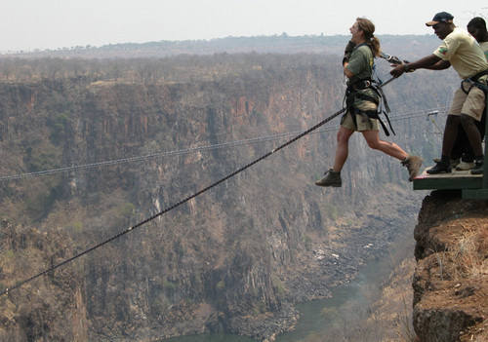

Slide 6
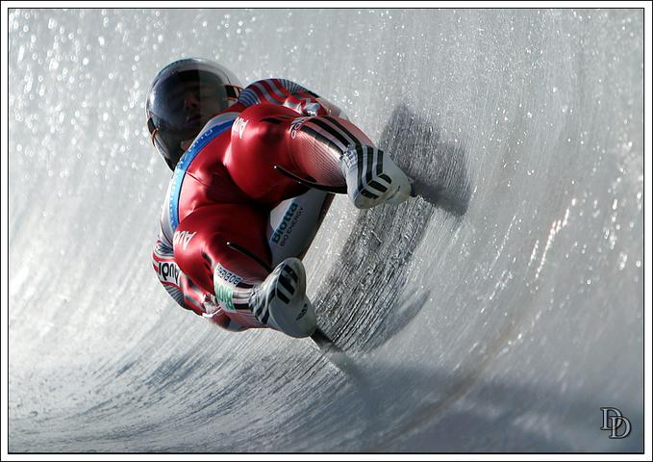

Slide 7
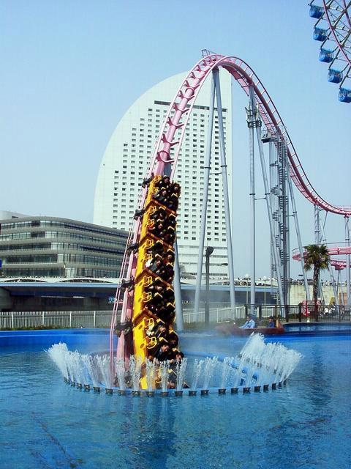

Slide 8
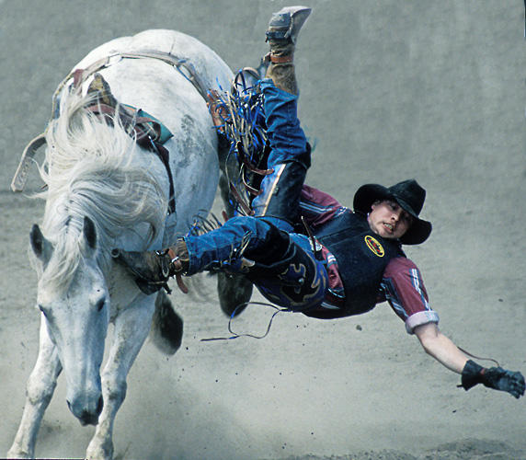

Slide 9
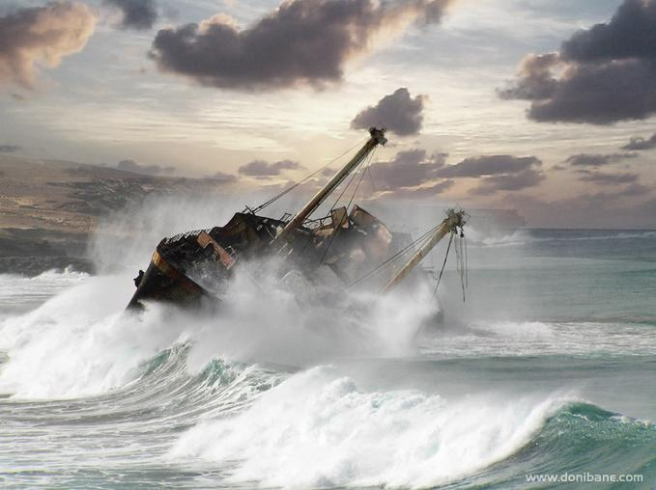

Slide 11
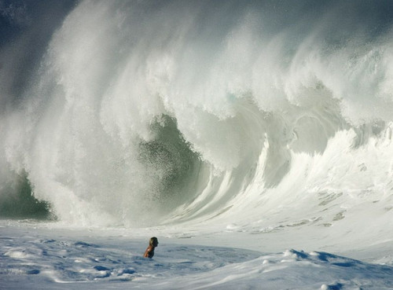

Slide 12
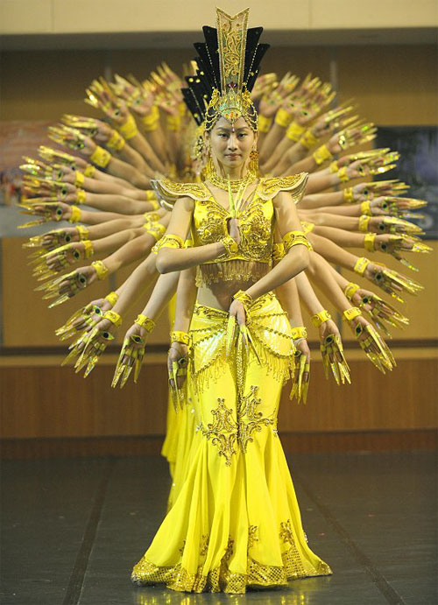

Slide 13
J BERRY ASSOCIATES LTD

Slide 14
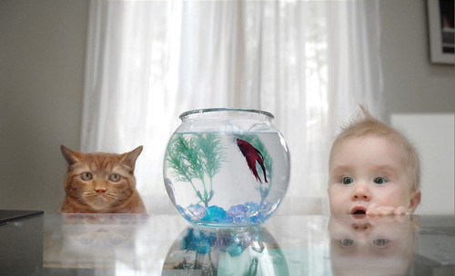
J BERRY ASSOCIATES LTD

Slide 15
Moving from one role to another: What makes it tough? Different challenges of internal and external promotion, NB

Slide 16
Moving from one role to another: What strategies can you use to make a success of it?

Slide 17
THINK ABOUT THE FOLLOWING: 1. Actively listening and learning 2. Making the most of the expertise of others and showing you value them 3. Getting the right balance between ‘inheriting’ and ‘inhabiting’ 4. Using very well the ‘lead-in’ period between being appointed and formally assuming the role 5. Not trying to reassure people by promising minimal change 6. Working on getting the right pace of change – neither too rapid nor too slow 7. Consultation without appearing to be indecisive/too ponderous 8. Reflecting, actively learning from experience and adapting 9. Not being too hard on yourself – expecting perfection 10. Achieving a sustainable balance in your life and working to ensure those you lead also make this a priority

Slide 18
Suggested further reading: Tips for Middle Leaders, Innovate My School: http://www.innovatemyschool.com/industry-expert-articles/item/1231-why-middle-leadership?.html The squeezed middle: 10 tips for Heads of Department, Jane Basnett (@basnettj), Innovate My School: http://www.innovatemyschool.com/industry-expert-articles/item/1323-the-squeezed-middle-10-tips-for-heads-of-department.html Why be a head of department? John Dexter (@MrJDexter): http://mrjdexter.com/2014/10/03/8yba-head-of-department/ Moving from middle to senior leadership, Mark Anderson (@ICTevangelist): http://ictevangelist.com/moving-middle-tlt13-session-wasnt/ Advice for new senior leaders, Stephen Tierney (@LeadingLearner): http://leadinglearner.me/2013/05/19/advice-to-new-senior-leaders/

Slide 19
Suggested further reading: Contemplating headship, Kev Bartle (@kevbartle): https://dailygenius.wordpress.com/2013/09/01/contemplating-headship/ Moving from senior leadership to headship, Innovate My School: http://www.innovatemyschool.com/industry-expert-articles/item/1425-moving-from-senior-leadership-to-headship.html The prospect of headship, Chris Hildrew (@chrishildrew): https://chrishildrew.wordpress.com/2015/07/12/the-prospect-of-headship/ Climbing the last rung of the ladder, TES: https://www.tes.co.uk/article.aspx?storycode=11007558 The 7 things top leaders do, Mary Myatt (@MaryMyatt): http://teachertoolkit.me/2014/04/18/the-7-things-top-leaders-do-by-marymyatt/

Slide 20
Photographs – thanks to: http://vi.sualize.us/ Nick Shell http://www.livescience.com/ https://uk.pinterest.com/chabasco/ https://otvet.mail/ru/ Donibane Sanjuan Margaret Shark Pixdaus.com Amazing and Unbelievable Photos Reinfreid Marass www.bhmpics.com

Slide 21
jillberry102@hotmail.co.uk @jillberry102

