Slide 1
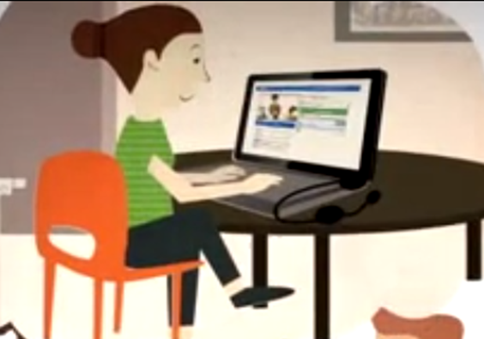
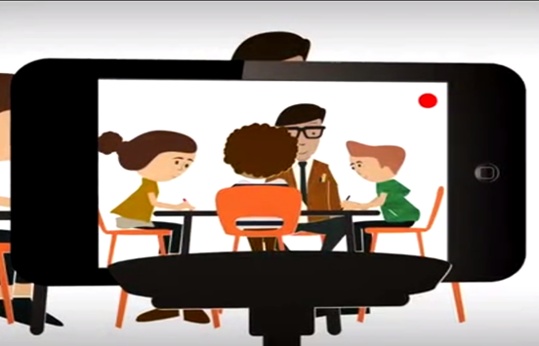

Slide 2
Lesson Context:
10.55 this is a few minutes into a Year 12 Btec Sport lesson.
This is the first lesson of a new unit and I’m trying to motivate attendance to an after school study club by using a progress tracker.
What did I take from it?

Slide 3
.
Could I have asked that question differently?
Why do I move around the classroom so much?
Should I have explained this concept like this instead?
How did I not notice those students off-task?

Slide 4
What would am I going to do differently next time I teach this class??
How am I going to teach this class better next time???
How am I going to teach this lesson content/concept better next time???
You will almost certainly notice something you think you can change next time…

Slide 5
Work on those lesson essentials…….
Peer Assessment | Oral Feedback
Oracy Expectation | Starters/Plenaries
Differentiation | MINT class/seating plan effect
List of additional adults | Group work
Questioning techniques | Behaviour Management

Slide 6
Using IRIS Connect to develop a CPD resource bank
.
Use the IRIS Connect Discovery kit to collate Outstanding practice that can be shared with others….
A subject specific CPD library
Don’t let a lack of time stop you from being a great coach!!

Slide 7
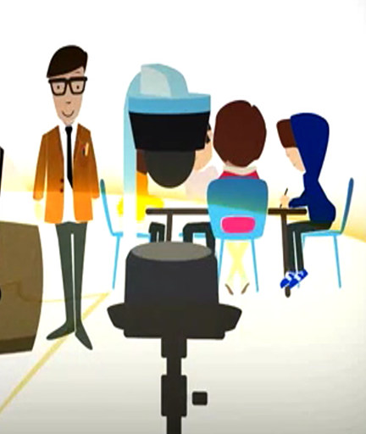
What would am I going to do differently next time I teach this class??
Having a bank of Outstanding practice would enable….
Modelling and sharing best practice
Timely and accurate support
Peer-to-peer observation
Collaborative culture

Slide 8
As a HOD, a team plan needs to discussed…..
What is the most urgent aspect of teaching for your department?
What do you feel most proud about?
Which aspect is simply the most convenient right now?
Who is going to use them and learn?

