Slide 1

Inspirational Leadership
of
Teaching and Learning
by
Ross Morrison McGill
@TeacherToolkit
Notes:
This presentation by @TeacherToolkit ( Ross Morrison McGill ) is licensed under a Creative Commons Attribution-NonCommercial-NoDerivs 3.0 Unported License. Based on all work published at www.teachertoolkit.me.
Produced for PiXL National Conference – 3rd December 2013

Slide 2
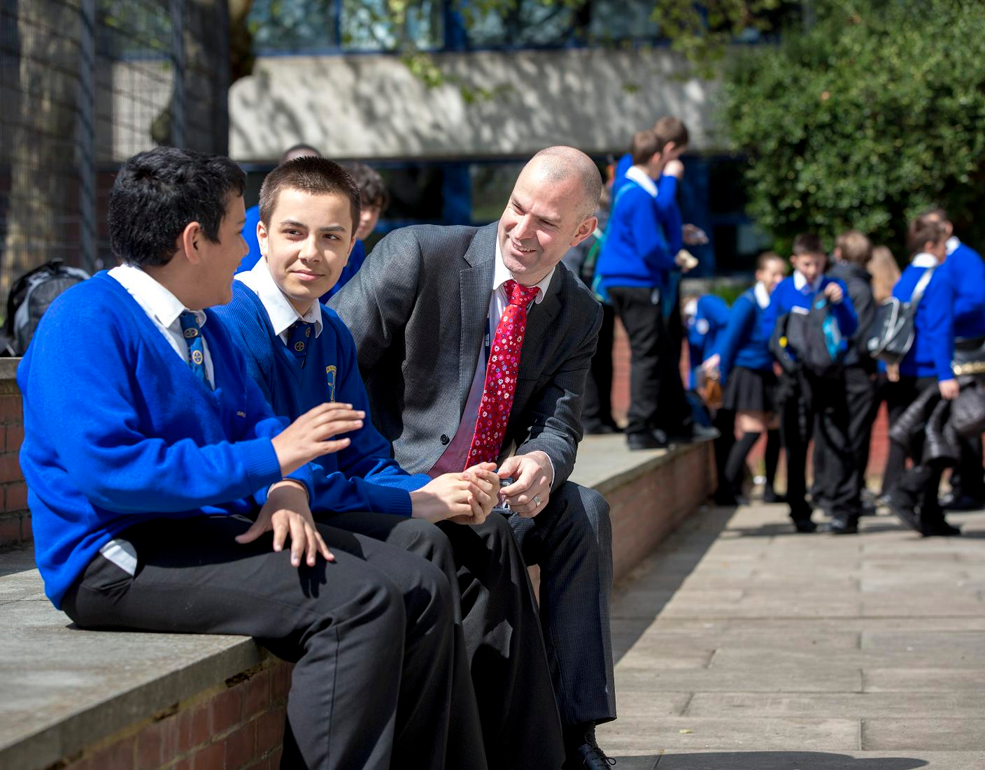
Role; context; background
Our journey at Greig City Academy
Wider exposure via social media.
Notes:
This presentation by @TeacherToolkit ( Ross Morrison McGill ) is licensed under a Creative Commons Attribution-NonCommercial-NoDerivs 3.0 Unported License. Based on all work published at www.teachertoolkit.me.
Produced for PiXL National Conference – 3rd December 2013

Slide 3

1157 students
237 sixth form
0.55 social deprivation
Context
Notes:
This presentation by @TeacherToolkit ( Ross Morrison McGill ) is licensed under a Creative Commons Attribution-NonCommercial-NoDerivs 3.0 Unported License. Based on all work published at www.teachertoolkit.me.
Produced for PiXL National Conference – 3rd December 2013

Slide 4
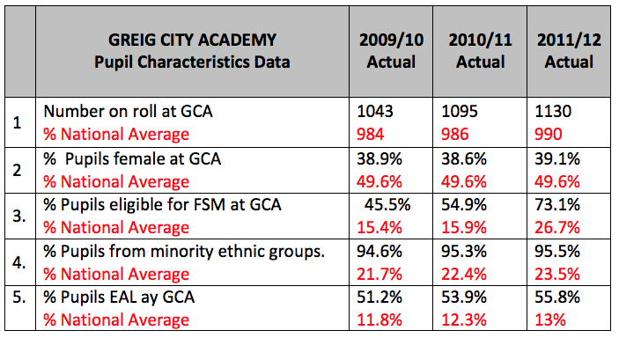
Landscape:
Notes:
This presentation by @TeacherToolkit ( Ross Morrison McGill ) is licensed under a Creative Commons Attribution-NonCommercial-NoDerivs 3.0 Unported License. Based on all work published at www.teachertoolkit.me.
Produced for PiXL National Conference – 3rd December 2013

Slide 5
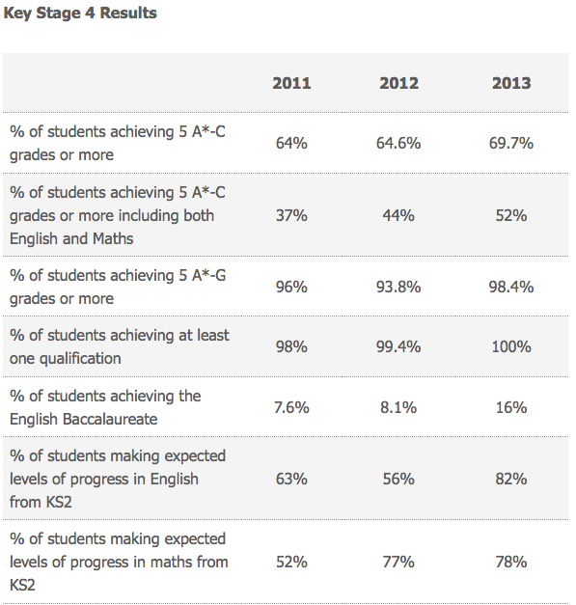
Outcomes:
Notes:
This presentation by @TeacherToolkit ( Ross Morrison McGill ) is licensed under a Creative Commons Attribution-NonCommercial-NoDerivs 3.0 Unported License. Based on all work published at www.teachertoolkit.me.
Produced for PiXL National Conference – 3rd December 2013

Slide 6
November 2011
Notes:
This presentation by @TeacherToolkit ( Ross Morrison McGill ) is licensed under a Creative Commons Attribution-NonCommercial-NoDerivs 3.0 Unported License. Based on all work published at www.teachertoolkit.me.
Produced for PiXL National Conference – 3rd December 2013

Slide 7
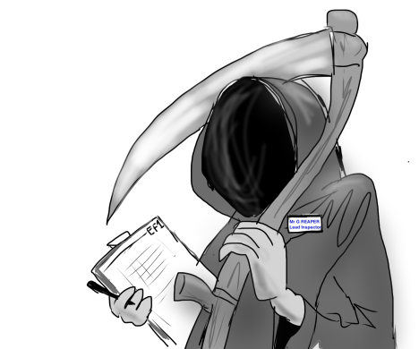
Ofsted:
Teaching and learning was judged 64% good or outstanding.
(November 2011)
Notes:
I arrived the day after!
This presentation by @TeacherToolkit ( Ross Morrison McGill ) is licensed under a Creative Commons Attribution-NonCommercial-NoDerivs 3.0 Unported License. Based on all work published at www.teachertoolkit.me.
Produced for PiXL National Conference – 3rd December 2013

Slide 8

Ofsted-blues…
I arrived the
next day…
Notes:
This presentation by @TeacherToolkit ( Ross Morrison McGill ) is licensed under a Creative Commons Attribution-NonCommercial-NoDerivs 3.0 Unported License. Based on all work published at www.teachertoolkit.me.
Produced for PiXL National Conference – 3rd December 2013

Slide 9

Virtually no records of appraisal
No clear culture of T&L
Notes:
Walk the school
Step into cover lessons; walkabout;;
Listen, listen, listen to issues. Ask staff for solutions
This presentation by @TeacherToolkit ( Ross Morrison McGill ) is licensed under a Creative Commons Attribution-NonCommercial-NoDerivs 3.0 Unported License. Based on all work published at www.teachertoolkit.me.
Produced for PiXL National Conference – 3rd December 2013

Slide 10

Notes:
This presentation by @TeacherToolkit ( Ross Morrison McGill ) is licensed under a Creative Commons Attribution-NonCommercial-NoDerivs 3.0 Unported License. Based on all work published at www.teachertoolkit.me.
Produced for PiXL National Conference – 3rd December 2013

Slide 11
December 2011
Notes:
This presentation by @TeacherToolkit ( Ross Morrison McGill ) is licensed under a Creative Commons Attribution-NonCommercial-NoDerivs 3.0 Unported License. Based on all work published at www.teachertoolkit.me.
Produced for PiXL National Conference – 3rd December 2013

Slide 12
Meet and greet
Support
Listen
Notes:
Walk the school
Step into cover lessons; walkabout;;
Listen, listen, listen to issues. Ask staff for solutions
This presentation by @TeacherToolkit ( Ross Morrison McGill ) is licensed under a Creative Commons Attribution-NonCommercial-NoDerivs 3.0 Unported License. Based on all work published at www.teachertoolkit.me.
Produced for PiXL National Conference – 3rd December 2013

Slide 13

Notes:
This presentation by @TeacherToolkit ( Ross Morrison McGill ) is licensed under a Creative Commons Attribution-NonCommercial-NoDerivs 3.0 Unported License. Based on all work published at www.teachertoolkit.me.
Produced for PiXL National Conference – 3rd December 2013

Slide 14

Share the concept
Plan a series of focus weeks.
Map the teacher, the location, the skill to share.
Promote everywhere.
Provide staff with a sign for their classroom.
Longer term: re-visit with good to outstanding etc.
Notes:
This presentation by @TeacherToolkit ( Ross Morrison McGill ) is licensed under a Creative Commons Attribution-NonCommercial-NoDerivs 3.0 Unported License. Based on all work published at www.teachertoolkit.me.
Produced for PiXL National Conference – 3rd December 2013

Slide 15

What’s going to work?
Teamwork!
Notes:
Wonderpets- Linny; Tuck & Ming-Ming
This presentation by @TeacherToolkit ( Ross Morrison McGill ) is licensed under a Creative Commons Attribution-NonCommercial-NoDerivs 3.0 Unported License. Based on all work published at www.teachertoolkit.me.
Produced for PiXL National Conference – 3rd December 2013

Slide 16
January - March 2012
Notes:
This presentation by @TeacherToolkit ( Ross Morrison McGill ) is licensed under a Creative Commons Attribution-NonCommercial-NoDerivs 3.0 Unported License. Based on all work published at www.teachertoolkit.me.
Produced for PiXL National Conference – 3rd December 2013

Slide 17
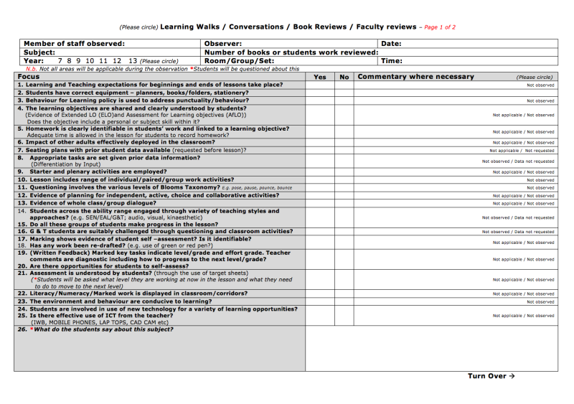
Learning Walks
Notes:
1st version – worked well – but became paper led.
This presentation by @TeacherToolkit ( Ross Morrison McGill ) is licensed under a Creative Commons Attribution-NonCommercial-NoDerivs 3.0 Unported License. Based on all work published at www.teachertoolkit.me.
Produced for PiXL National Conference – 3rd December 2013

Slide 18
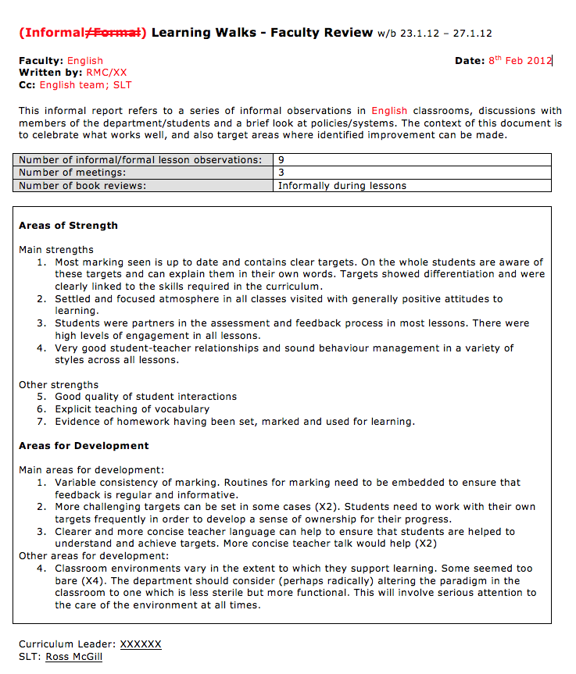
Learning
Walks
report
Notes:
This presentation by @TeacherToolkit ( Ross Morrison McGill ) is licensed under a Creative Commons Attribution-NonCommercial-NoDerivs 3.0 Unported License. Based on all work published at www.teachertoolkit.me.
Produced for PiXL National Conference – 3rd December 2013

Slide 19
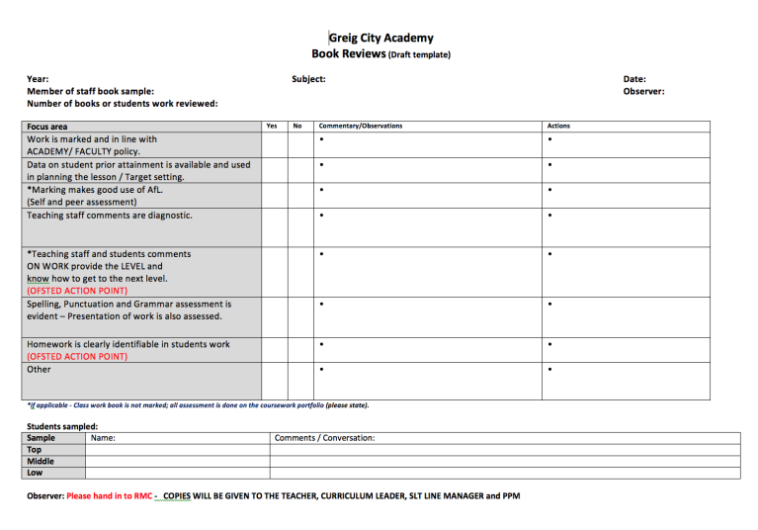
Book Reviews
Notes:
This presentation by @TeacherToolkit ( Ross Morrison McGill ) is licensed under a Creative Commons Attribution-NonCommercial-NoDerivs 3.0 Unported License. Based on all work published at www.teachertoolkit.me.
Produced for PiXL National Conference – 3rd December 2013

Slide 20
April – June 2012
Notes:
This presentation by @TeacherToolkit ( Ross Morrison McGill ) is licensed under a Creative Commons Attribution-NonCommercial-NoDerivs 3.0 Unported License. Based on all work published at www.teachertoolkit.me.
Produced for PiXL National Conference – 3rd December 2013

Slide 21
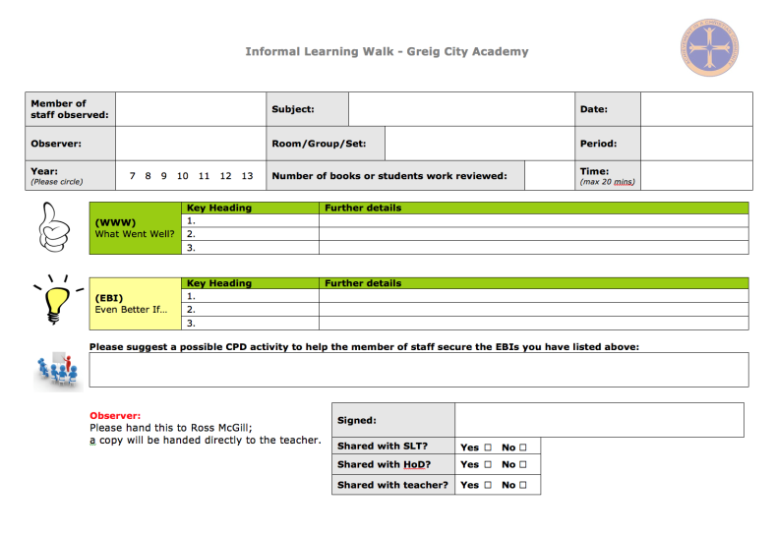
Learning Walks – part 2
Notes:
This presentation by @TeacherToolkit ( Ross Morrison McGill ) is licensed under a Creative Commons Attribution-NonCommercial-NoDerivs 3.0 Unported License. Based on all work published at www.teachertoolkit.me.
Produced for PiXL National Conference – 3rd December 2013

Slide 22
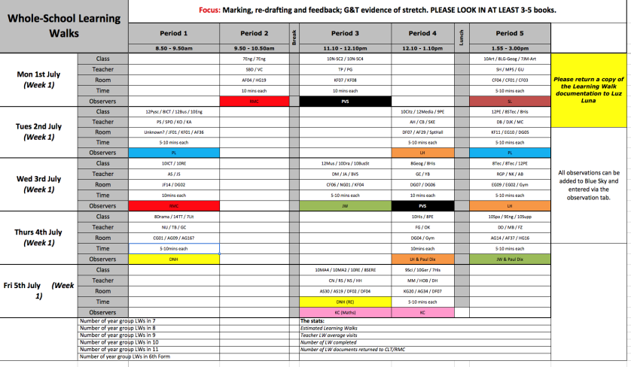
Learning Walks cycle
Notes:
This presentation by @TeacherToolkit ( Ross Morrison McGill ) is licensed under a Creative Commons Attribution-NonCommercial-NoDerivs 3.0 Unported License. Based on all work published at www.teachertoolkit.me.
Produced for PiXL National Conference – 3rd December 2013

Slide 23
Consistency!
Marking
Literacy
G&T
Notes:
This presentation by @TeacherToolkit ( Ross Morrison McGill ) is licensed under a Creative Commons Attribution-NonCommercial-NoDerivs 3.0 Unported License. Based on all work published at www.teachertoolkit.me.
Produced for PiXL National Conference – 3rd December 2013

Slide 24
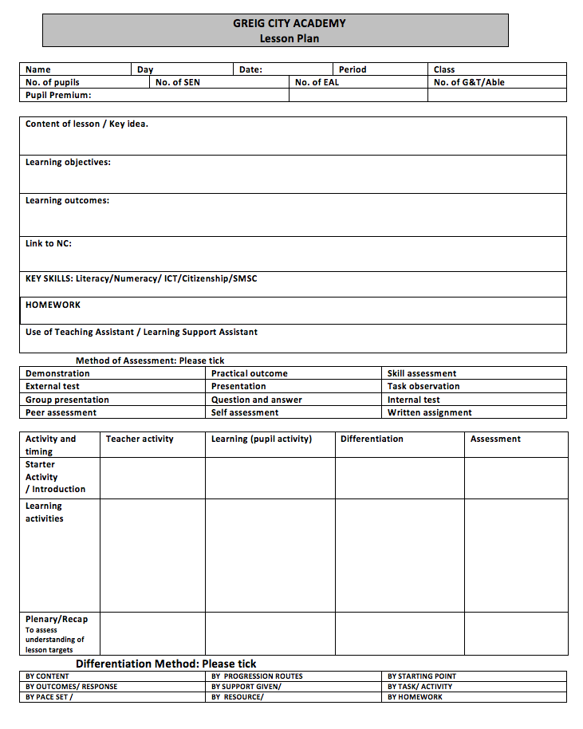
Formal
lesson
plan
Notes:
This presentation by @TeacherToolkit ( Ross Morrison McGill ) is licensed under a Creative Commons Attribution-NonCommercial-NoDerivs 3.0 Unported License. Based on all work published at www.teachertoolkit.me.
Produced for PiXL National Conference – 3rd December 2013

Slide 25
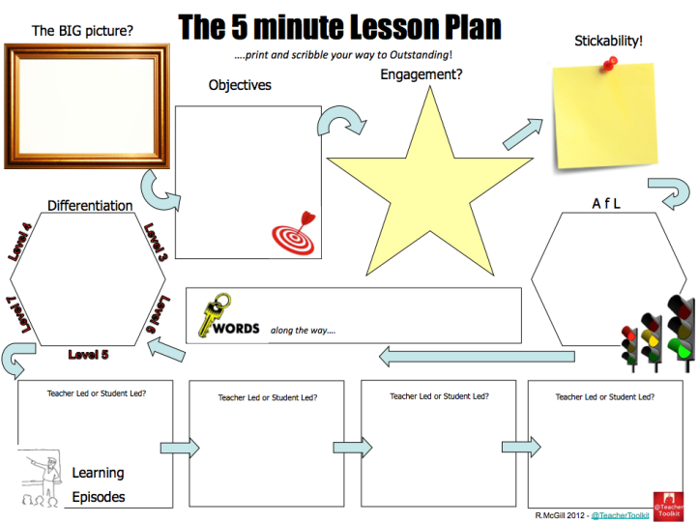
Informal lesson plan
Notes:
This presentation by @TeacherToolkit ( Ross Morrison McGill ) is licensed under a Creative Commons Attribution-NonCommercial-NoDerivs 3.0 Unported License. Based on all work published at www.teachertoolkit.me.
Produced for PiXL National Conference – 3rd December 2013

Slide 26

Cover
Notes:
This presentation by @TeacherToolkit ( Ross Morrison McGill ) is licensed under a Creative Commons Attribution-NonCommercial-NoDerivs 3.0 Unported License. Based on all work published at www.teachertoolkit.me.
Produced for PiXL National Conference – 3rd December 2013

Slide 27
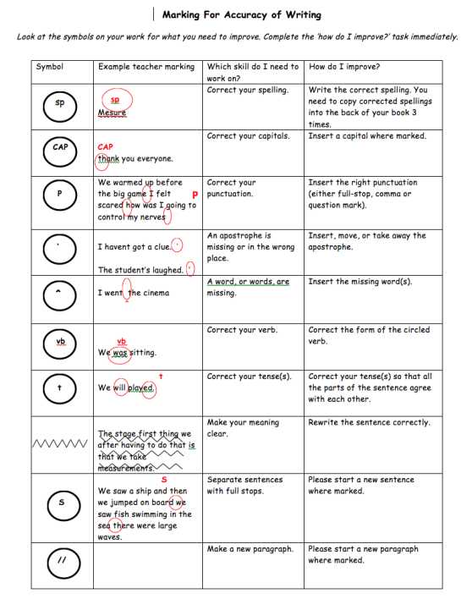
Notes:
This presentation by @TeacherToolkit ( Ross Morrison McGill ) is licensed under a Creative Commons Attribution-NonCommercial-NoDerivs 3.0 Unported License. Based on all work published at www.teachertoolkit.me.
Produced for PiXL National Conference – 3rd December 2013

Slide 28
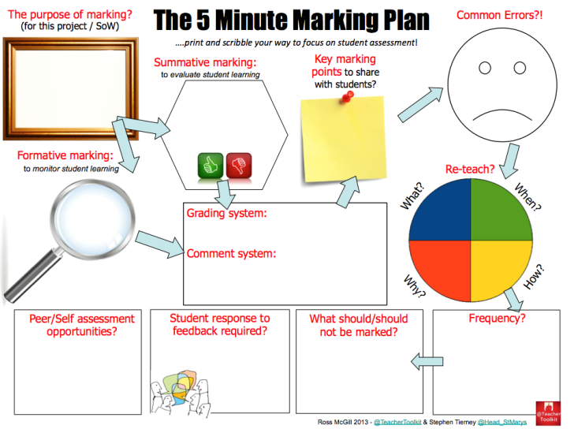
Notes:
This presentation by @TeacherToolkit ( Ross Morrison McGill ) is licensed under a Creative Commons Attribution-NonCommercial-NoDerivs 3.0 Unported License. Based on all work published at www.teachertoolkit.me.
Produced for PiXL National Conference – 3rd December 2013

Slide 29
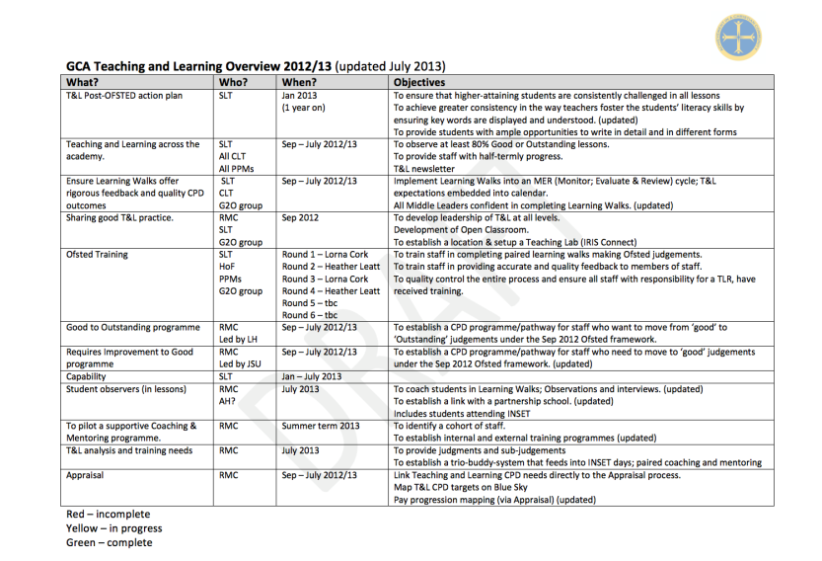
T&L action plan
Notes:
This presentation by @TeacherToolkit ( Ross Morrison McGill ) is licensed under a Creative Commons Attribution-NonCommercial-NoDerivs 3.0 Unported License. Based on all work published at www.teachertoolkit.me.
Produced for PiXL National Conference – 3rd December 2013

Slide 30
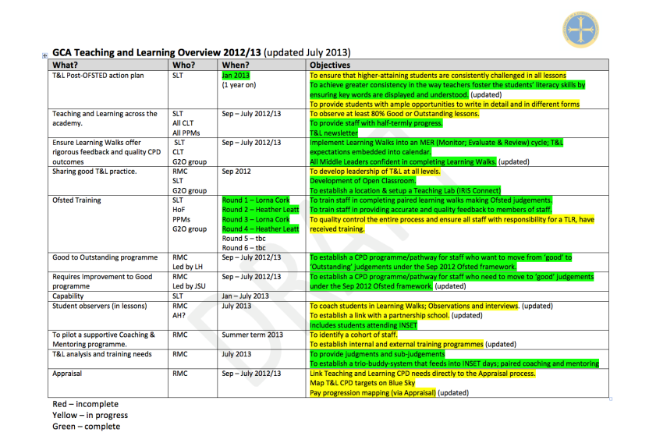
T&L action plan
Notes:
This presentation by @TeacherToolkit ( Ross Morrison McGill ) is licensed under a Creative Commons Attribution-NonCommercial-NoDerivs 3.0 Unported License. Based on all work published at www.teachertoolkit.me.
Produced for PiXL National Conference – 3rd December 2013

Slide 31
September 2012
Notes:
This presentation by @TeacherToolkit ( Ross Morrison McGill ) is licensed under a Creative Commons Attribution-NonCommercial-NoDerivs 3.0 Unported License. Based on all work published at www.teachertoolkit.me.
Produced for PiXL National Conference – 3rd December 2013

Slide 32

Notes:
This presentation by @TeacherToolkit ( Ross Morrison McGill ) is licensed under a Creative Commons Attribution-NonCommercial-NoDerivs 3.0 Unported License. Based on all work published at www.teachertoolkit.me.
Produced for PiXL National Conference – 3rd December 2013

Slide 33
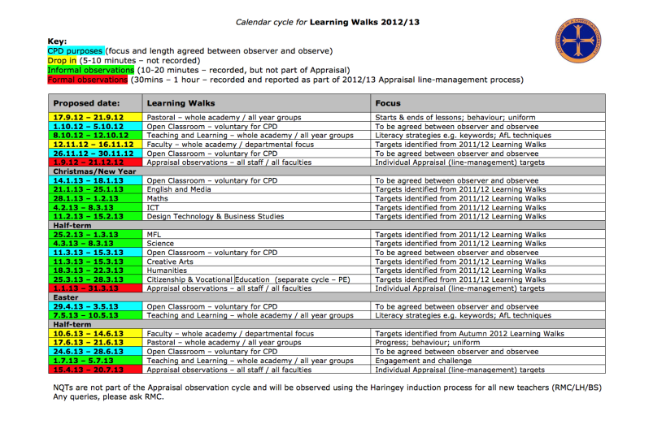
Observation cycle
Notes:
This presentation by @TeacherToolkit ( Ross Morrison McGill ) is licensed under a Creative Commons Attribution-NonCommercial-NoDerivs 3.0 Unported License. Based on all work published at www.teachertoolkit.me.
Produced for PiXL National Conference – 3rd December 2013

Slide 34
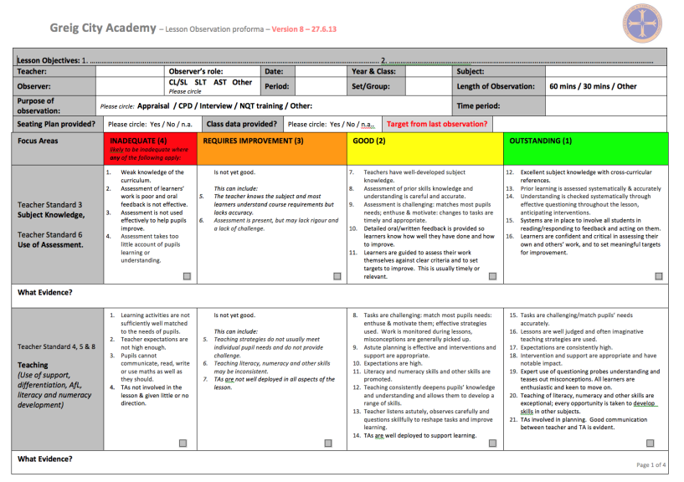
Collaboration
Notes:
This presentation by @TeacherToolkit ( Ross Morrison McGill ) is licensed under a Creative Commons Attribution-NonCommercial-NoDerivs 3.0 Unported License. Based on all work published at www.teachertoolkit.me.
Produced for PiXL National Conference – 3rd December 2013

Slide 35
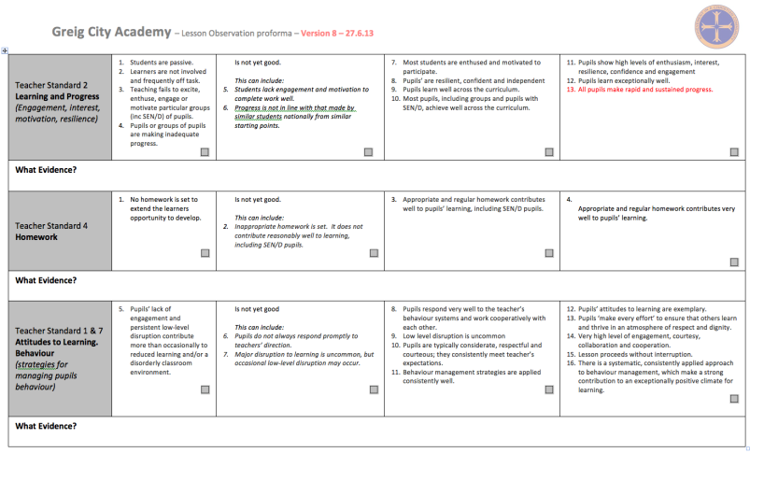
Collaboration
Notes:
This presentation by @TeacherToolkit ( Ross Morrison McGill ) is licensed under a Creative Commons Attribution-NonCommercial-NoDerivs 3.0 Unported License. Based on all work published at www.teachertoolkit.me.
Produced for PiXL National Conference – 3rd December 2013

Slide 36
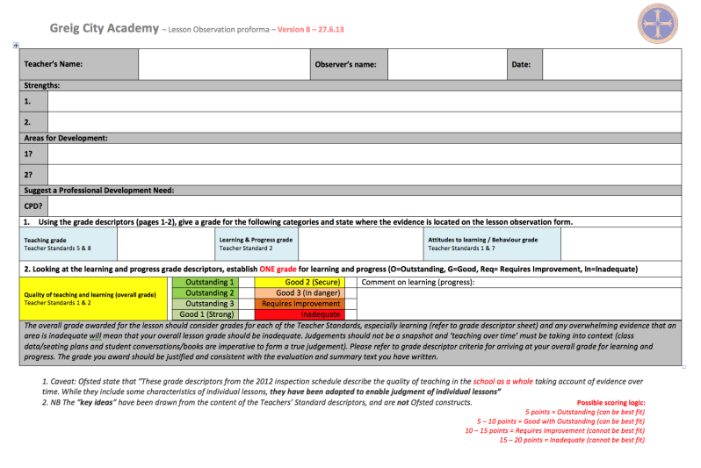
Collaboration
Notes:
This presentation by @TeacherToolkit ( Ross Morrison McGill ) is licensed under a Creative Commons Attribution-NonCommercial-NoDerivs 3.0 Unported License. Based on all work published at www.teachertoolkit.me.
Produced for PiXL National Conference – 3rd December 2013

Slide 37
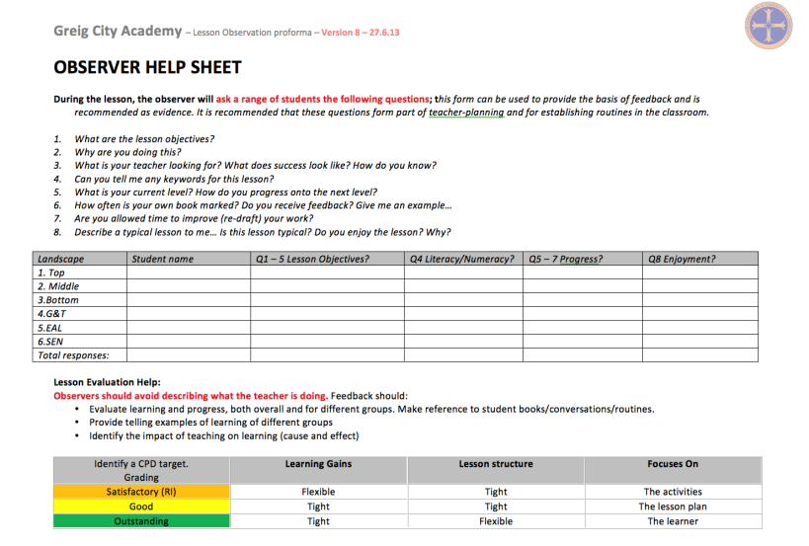
Notes:
This presentation by @TeacherToolkit ( Ross Morrison McGill ) is licensed under a Creative Commons Attribution-NonCommercial-NoDerivs 3.0 Unported License. Based on all work published at www.teachertoolkit.me.
Produced for PiXL National Conference – 3rd December 2013

Slide 38
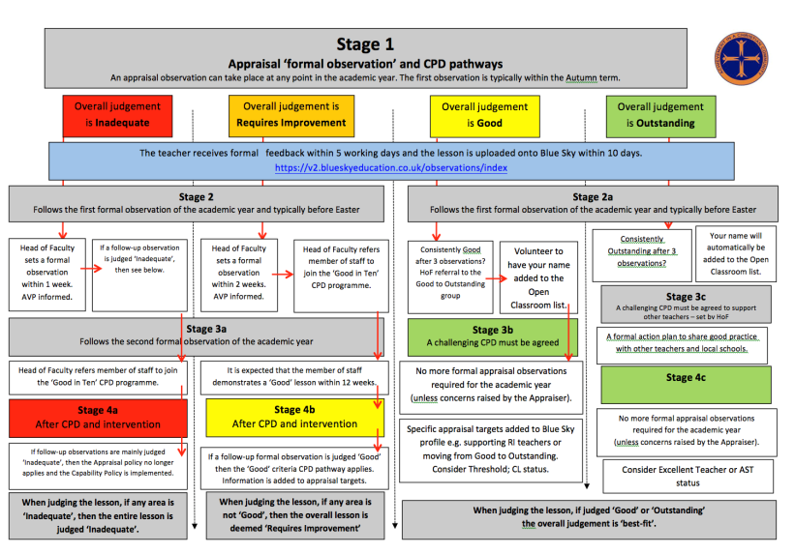
Notes:
This presentation by @TeacherToolkit ( Ross Morrison McGill ) is licensed under a Creative Commons Attribution-NonCommercial-NoDerivs 3.0 Unported License. Based on all work published at www.teachertoolkit.me.
Produced for PiXL National Conference – 3rd December 2013

Slide 39

Bombshell!
Notes:
This presentation by @TeacherToolkit ( Ross Morrison McGill ) is licensed under a Creative Commons Attribution-NonCommercial-NoDerivs 3.0 Unported License. Based on all work published at www.teachertoolkit.me.
Produced for PiXL National Conference – 3rd December 2013

Slide 40
“Ofsted do not require
a lesson plan;
but evidence of
a planned lesson!”
Ofsted Handbook: September 2012 and then again in 2013
Notes:
This presentation by @TeacherToolkit ( Ross Morrison McGill ) is licensed under a Creative Commons Attribution-NonCommercial-NoDerivs 3.0 Unported License. Based on all work published at www.teachertoolkit.me.
Produced for PiXL National Conference – 3rd December 2013

Slide 41

What do Ofsted say?
The School Inspections Handbook – Sep 2013
Page 10 – Bullet 24: Ofsted say:
“Inspectors must not advocate a particular method of teaching or show preference towards a specific lesson structure.”
Notes:
This presentation by @TeacherToolkit ( Ross Morrison McGill ) is licensed under a Creative Commons Attribution-NonCommercial-NoDerivs 3.0 Unported License. Based on all work published at www.teachertoolkit.me.
Produced for PiXL National Conference – 3rd December 2013

Slide 42
Page 11 – Bullet 27: Ofsted say from September
“Inspectors will not expect teachers to prepare lesson plans for the inspection. However, they will use the evidence gathered from lesson observations to help judge the overall quality of the school’s curriculum planning.“
Notes:
This presentation by @TeacherToolkit ( Ross Morrison McGill ) is licensed under a Creative Commons Attribution-NonCommercial-NoDerivs 3.0 Unported License. Based on all work published at www.teachertoolkit.me.
Produced for PiXL National Conference – 3rd December 2013

Slide 43



Paired learning walks
Notes:
This presentation by @TeacherToolkit ( Ross Morrison McGill ) is licensed under a Creative Commons Attribution-NonCommercial-NoDerivs 3.0 Unported License. Based on all work published at www.teachertoolkit.me.
Produced for PiXL National Conference – 3rd December 2013

Slide 44
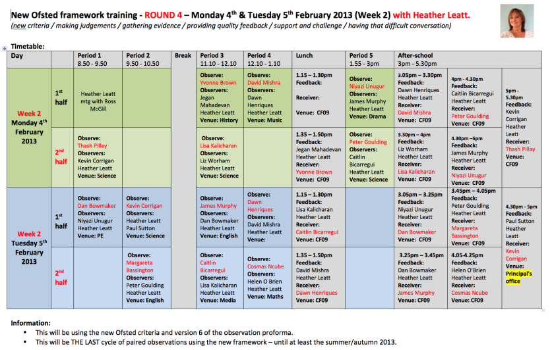
1. Observe and feedback
2. Observed and receive feedback
Notes:
This presentation by @TeacherToolkit ( Ross Morrison McGill ) is licensed under a Creative Commons Attribution-NonCommercial-NoDerivs 3.0 Unported License. Based on all work published at www.teachertoolkit.me.
Produced for PiXL National Conference – 3rd December 2013

Slide 45
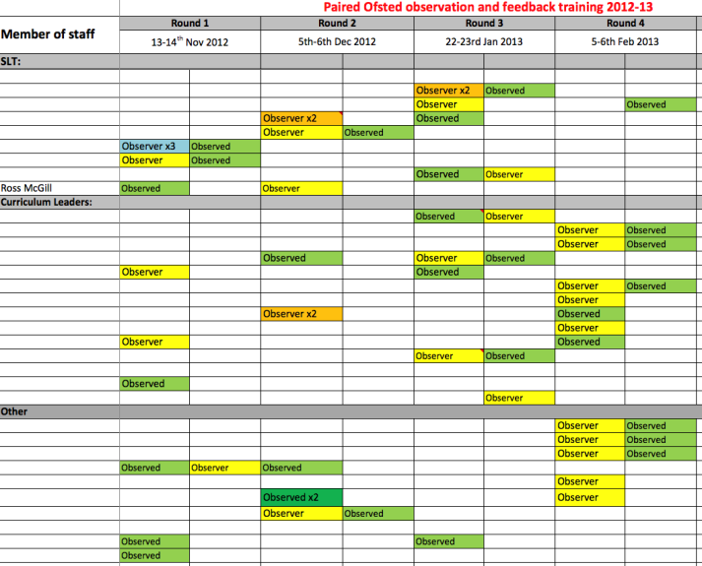
Notes:
This presentation by @TeacherToolkit ( Ross Morrison McGill ) is licensed under a Creative Commons Attribution-NonCommercial-NoDerivs 3.0 Unported License. Based on all work published at www.teachertoolkit.me.
Produced for PiXL National Conference – 3rd December 2013

Slide 46
Revisited lesson planning…
Notes:
This presentation by @TeacherToolkit ( Ross Morrison McGill ) is licensed under a Creative Commons Attribution-NonCommercial-NoDerivs 3.0 Unported License. Based on all work published at www.teachertoolkit.me.
Produced for PiXL National Conference – 3rd December 2013

Slide 47
Revisited lesson planning
Notes:
This presentation by @TeacherToolkit ( Ross Morrison McGill ) is licensed under a Creative Commons Attribution-NonCommercial-NoDerivs 3.0 Unported License. Based on all work published at www.teachertoolkit.me.
Produced for PiXL National Conference – 3rd December 2013

Slide 48

‘Stickability’:
What will stick in pupils’ minds as they leave your lesson?
What do you want them to bring back to the next lesson?
Notes:
This presentation by @TeacherToolkit ( Ross Morrison McGill ) is licensed under a Creative Commons Attribution-NonCommercial-NoDerivs 3.0 Unported License. Based on all work published at www.teachertoolkit.me.
Produced for PiXL National Conference – 3rd December 2013

Slide 49
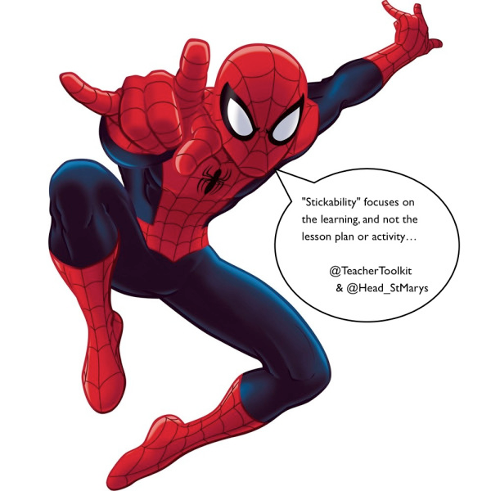
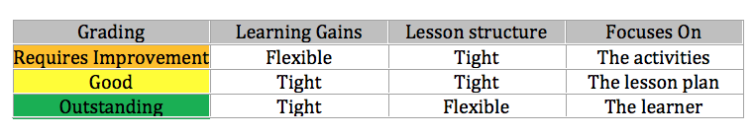
Credit: Stephen Tierney (@LeadingLearner)
Notes:
This presentation by @TeacherToolkit ( Ross Morrison McGill ) is licensed under a Creative Commons Attribution-NonCommercial-NoDerivs 3.0 Unported License. Based on all work published at www.teachertoolkit.me.
Produced for PiXL National Conference – 3rd December 2013

Slide 50
AfL
Differentiation
Questioning
Notes:
This presentation by @TeacherToolkit ( Ross Morrison McGill ) is licensed under a Creative Commons Attribution-NonCommercial-NoDerivs 3.0 Unported License. Based on all work published at www.teachertoolkit.me.
Produced for PiXL National Conference – 3rd December 2013

Slide 51

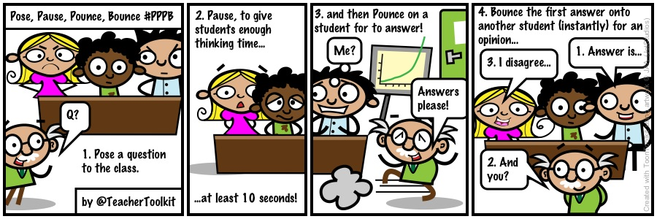
Pose Pause Pounce Bounce!
(PPPB)
Notes:
This presentation by @TeacherToolkit ( Ross Morrison McGill ) is licensed under a Creative Commons Attribution-NonCommercial-NoDerivs 3.0 Unported License. Based on all work published at www.teachertoolkit.me.
Produced for PiXL National Conference – 3rd December 2013

Slide 52
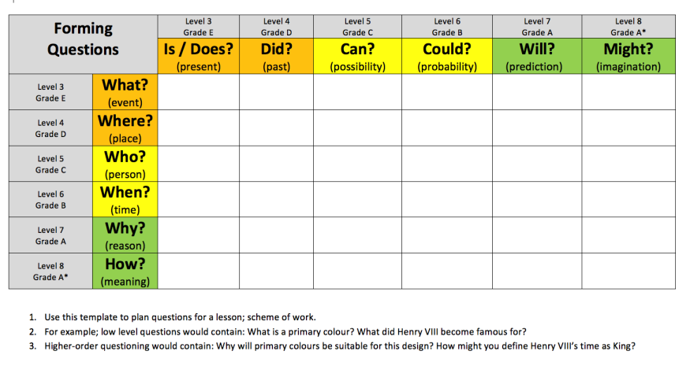
Forming questions
Notes:
This presentation by @TeacherToolkit ( Ross Morrison McGill ) is licensed under a Creative Commons Attribution-NonCommercial-NoDerivs 3.0 Unported License. Based on all work published at www.teachertoolkit.me.
Produced for PiXL National Conference – 3rd December 2013

Slide 53
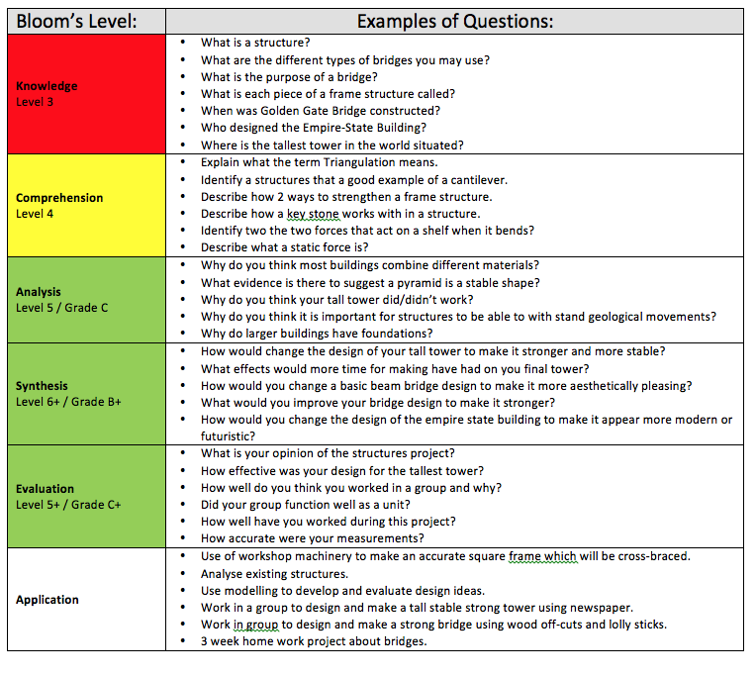
Forming questions with Blooms
Notes:
This presentation by @TeacherToolkit ( Ross Morrison McGill ) is licensed under a Creative Commons Attribution-NonCommercial-NoDerivs 3.0 Unported License. Based on all work published at www.teachertoolkit.me.
Produced for PiXL National Conference – 3rd December 2013

Slide 54
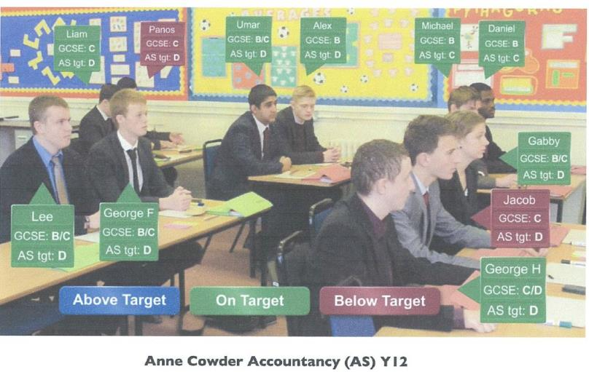
Visual seating plans - ASCL example
Notes:
This presentation by @TeacherToolkit ( Ross Morrison McGill ) is licensed under a Creative Commons Attribution-NonCommercial-NoDerivs 3.0 Unported License. Based on all work published at www.teachertoolkit.me.
Produced for PiXL National Conference – 3rd December 2013

Slide 55
Reporting on standards
Notes:
This presentation by @TeacherToolkit ( Ross Morrison McGill ) is licensed under a Creative Commons Attribution-NonCommercial-NoDerivs 3.0 Unported License. Based on all work published at www.teachertoolkit.me.
Produced for PiXL National Conference – 3rd December 2013

Slide 56
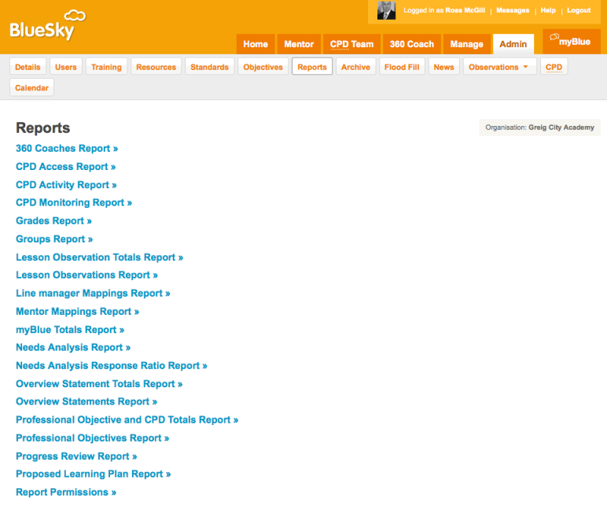
Blue Sky Education
Notes:
This presentation by @TeacherToolkit ( Ross Morrison McGill ) is licensed under a Creative Commons Attribution-NonCommercial-NoDerivs 3.0 Unported License. Based on all work published at www.teachertoolkit.me.
Produced for PiXL National Conference – 3rd December 2013

Slide 57
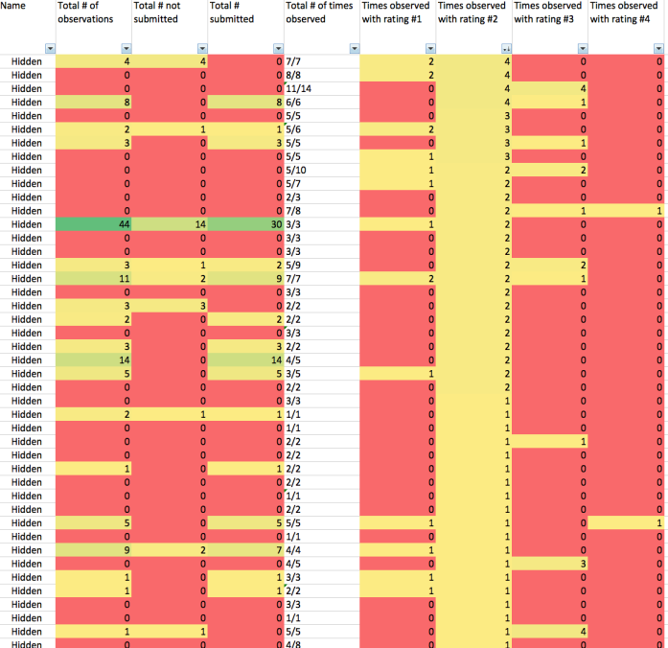
Notes:
This presentation by @TeacherToolkit ( Ross Morrison McGill ) is licensed under a Creative Commons Attribution-NonCommercial-NoDerivs 3.0 Unported License. Based on all work published at www.teachertoolkit.me.
Produced for PiXL National Conference – 3rd December 2013

Slide 58
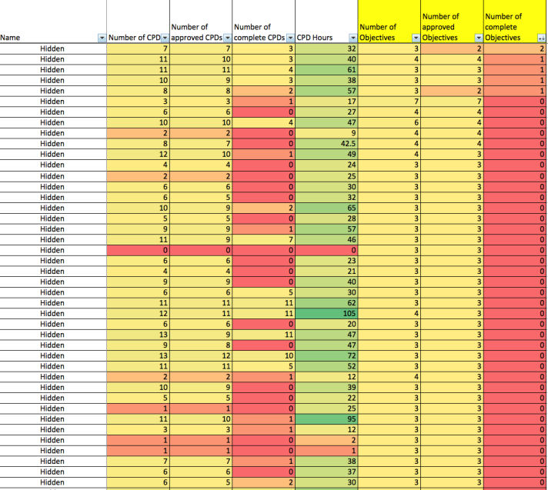
Notes:
This presentation by @TeacherToolkit ( Ross Morrison McGill ) is licensed under a Creative Commons Attribution-NonCommercial-NoDerivs 3.0 Unported License. Based on all work published at www.teachertoolkit.me.
Produced for PiXL National Conference – 3rd December 2013

Slide 59
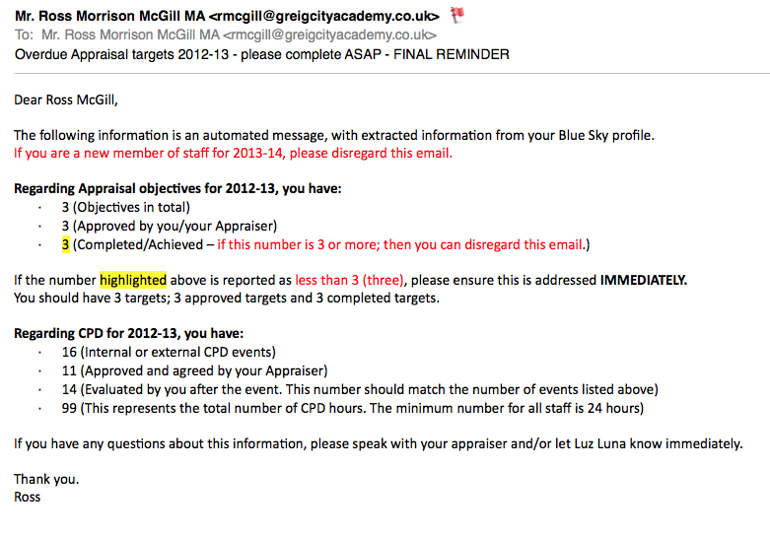
Automated email updates
Notes:
This presentation by @TeacherToolkit ( Ross Morrison McGill ) is licensed under a Creative Commons Attribution-NonCommercial-NoDerivs 3.0 Unported License. Based on all work published at www.teachertoolkit.me.
Produced for PiXL National Conference – 3rd December 2013

Slide 60
Reporting to governors
Notes:
This presentation by @TeacherToolkit ( Ross Morrison McGill ) is licensed under a Creative Commons Attribution-NonCommercial-NoDerivs 3.0 Unported License. Based on all work published at www.teachertoolkit.me.
Produced for PiXL National Conference – 3rd December 2013

Slide 61
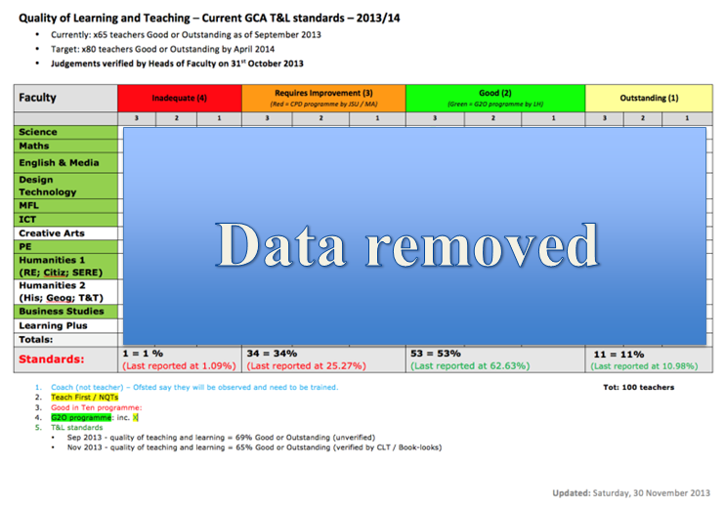
Notes:
This presentation by @TeacherToolkit ( Ross Morrison McGill ) is licensed under a Creative Commons Attribution-NonCommercial-NoDerivs 3.0 Unported License. Based on all work published at www.teachertoolkit.me.
Produced for PiXL National Conference – 3rd December 2013

Slide 62
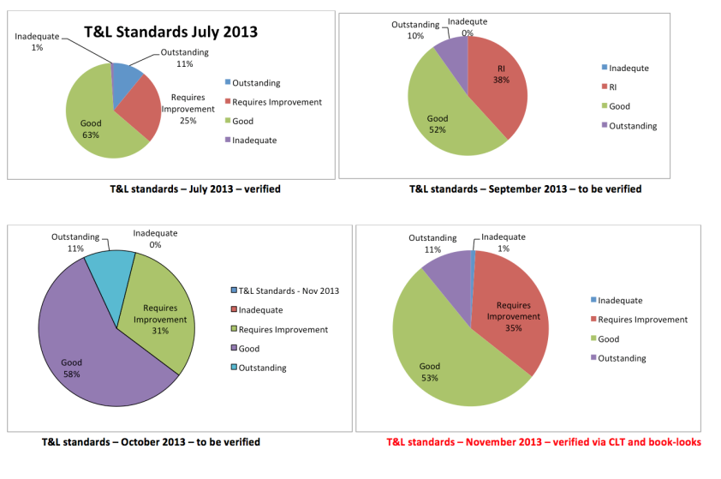
Notes:
This presentation by @TeacherToolkit ( Ross Morrison McGill ) is licensed under a Creative Commons Attribution-NonCommercial-NoDerivs 3.0 Unported License. Based on all work published at www.teachertoolkit.me.
Produced for PiXL National Conference – 3rd December 2013

Slide 63
C P D
Notes:
This presentation by @TeacherToolkit ( Ross Morrison McGill ) is licensed under a Creative Commons Attribution-NonCommercial-NoDerivs 3.0 Unported License. Based on all work published at www.teachertoolkit.me.
Produced for PiXL National Conference – 3rd December 2013

Slide 64
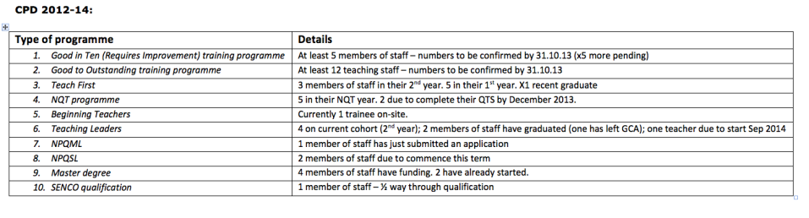
CPD across the school
Notes:
This presentation by @TeacherToolkit ( Ross Morrison McGill ) is licensed under a Creative Commons Attribution-NonCommercial-NoDerivs 3.0 Unported License. Based on all work published at www.teachertoolkit.me.
Produced for PiXL National Conference – 3rd December 2013

Slide 65
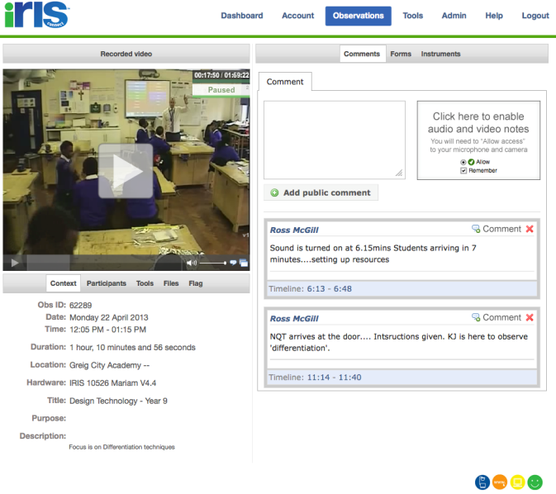
IRIS Connect
Notes:
This presentation by @TeacherToolkit ( Ross Morrison McGill ) is licensed under a Creative Commons Attribution-NonCommercial-NoDerivs 3.0 Unported License. Based on all work published at www.teachertoolkit.me.
Produced for PiXL National Conference – 3rd December 2013

Slide 66
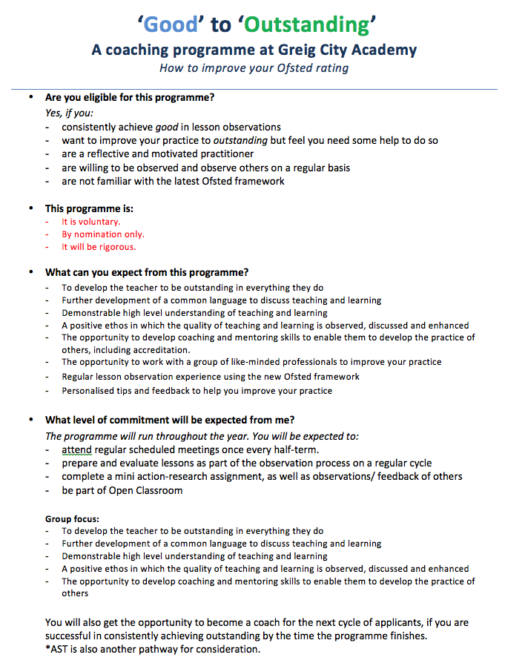
Notes:
This presentation by @TeacherToolkit ( Ross Morrison McGill ) is licensed under a Creative Commons Attribution-NonCommercial-NoDerivs 3.0 Unported License. Based on all work published at www.teachertoolkit.me.
Produced for PiXL National Conference – 3rd December 2013

Slide 67
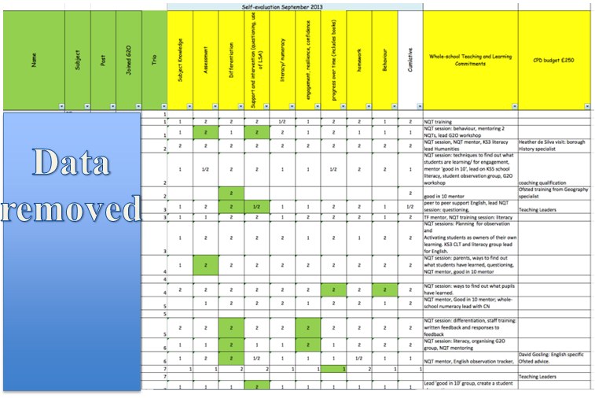
Good to Outstanding
Notes:
This presentation by @TeacherToolkit ( Ross Morrison McGill ) is licensed under a Creative Commons Attribution-NonCommercial-NoDerivs 3.0 Unported License. Based on all work published at www.teachertoolkit.me.
Produced for PiXL National Conference – 3rd December 2013

Slide 68
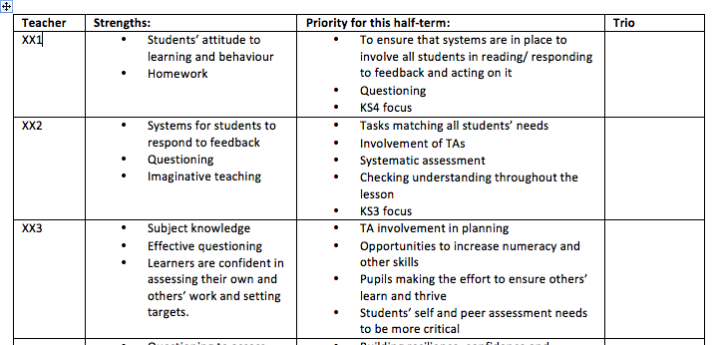
Good to Outstanding
Notes:
This presentation by @TeacherToolkit ( Ross Morrison McGill ) is licensed under a Creative Commons Attribution-NonCommercial-NoDerivs 3.0 Unported License. Based on all work published at www.teachertoolkit.me.
Produced for PiXL National Conference – 3rd December 2013

Slide 69

Requires
Improvement
Notes:
This presentation by @TeacherToolkit ( Ross Morrison McGill ) is licensed under a Creative Commons Attribution-NonCommercial-NoDerivs 3.0 Unported License. Based on all work published at www.teachertoolkit.me.
Produced for PiXL National Conference – 3rd December 2013

Slide 70

Requires
Improvement
Notes:
This presentation by @TeacherToolkit ( Ross Morrison McGill ) is licensed under a Creative Commons Attribution-NonCommercial-NoDerivs 3.0 Unported License. Based on all work published at www.teachertoolkit.me.
Produced for PiXL National Conference – 3rd December 2013

Slide 71
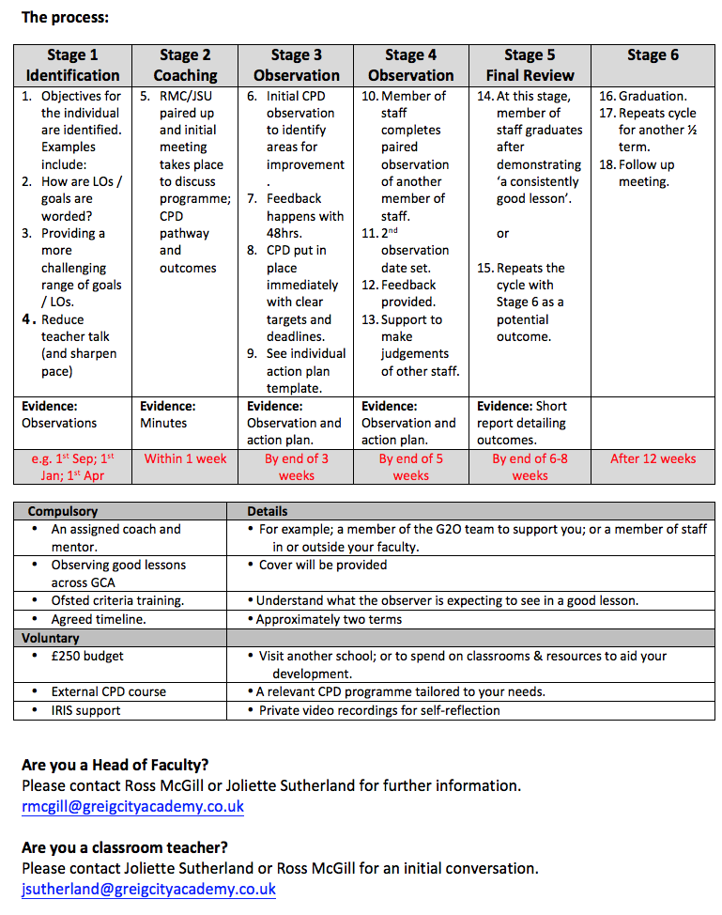
Requires
Improvement
Notes:
This presentation by @TeacherToolkit ( Ross Morrison McGill ) is licensed under a Creative Commons Attribution-NonCommercial-NoDerivs 3.0 Unported License. Based on all work published at www.teachertoolkit.me.
Produced for PiXL National Conference – 3rd December 2013

Slide 72
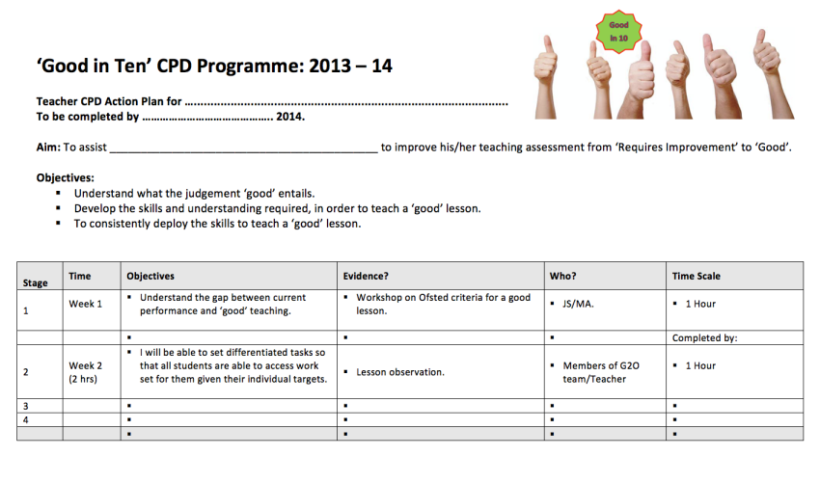
Requires Improvement Action Plan
Notes:
This presentation by @TeacherToolkit ( Ross Morrison McGill ) is licensed under a Creative Commons Attribution-NonCommercial-NoDerivs 3.0 Unported License. Based on all work published at www.teachertoolkit.me.
Produced for PiXL National Conference – 3rd December 2013

Slide 73
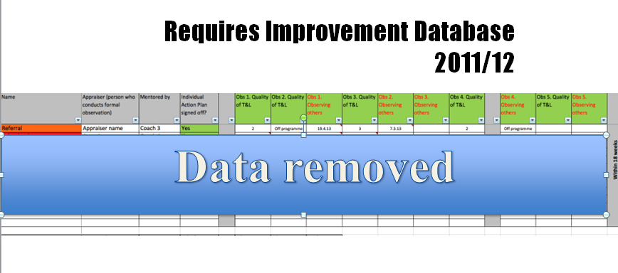
Notes:
This presentation by @TeacherToolkit ( Ross Morrison McGill ) is licensed under a Creative Commons Attribution-NonCommercial-NoDerivs 3.0 Unported License. Based on all work published at www.teachertoolkit.me.
Produced for PiXL National Conference – 3rd December 2013

Slide 74
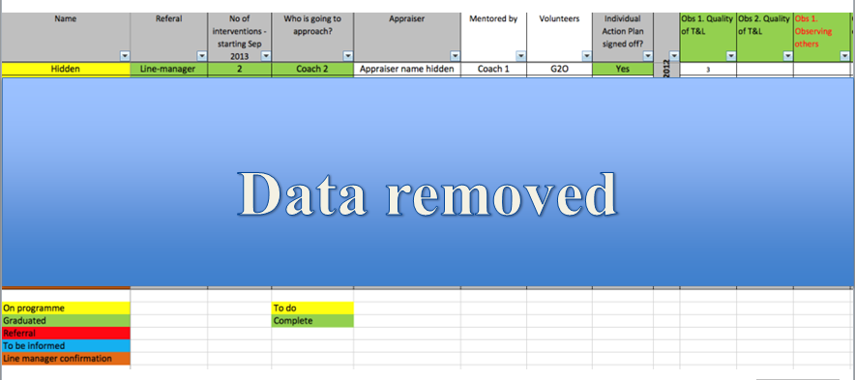
Requires Improvement Database 2012/13
Notes:
This presentation by @TeacherToolkit ( Ross Morrison McGill ) is licensed under a Creative Commons Attribution-NonCommercial-NoDerivs 3.0 Unported License. Based on all work published at www.teachertoolkit.me.
Produced for PiXL National Conference – 3rd December 2013

Slide 75
September 2013
Notes:
This presentation by @TeacherToolkit ( Ross Morrison McGill ) is licensed under a Creative Commons Attribution-NonCommercial-NoDerivs 3.0 Unported License. Based on all work published at www.teachertoolkit.me.
Produced for PiXL National Conference – 3rd December 2013

Slide 76

Notes:
This presentation by @TeacherToolkit ( Ross Morrison McGill ) is licensed under a Creative Commons Attribution-NonCommercial-NoDerivs 3.0 Unported License. Based on all work published at www.teachertoolkit.me.
Produced for PiXL National Conference – 3rd December 2013

Slide 77

Notes:
This presentation by @TeacherToolkit ( Ross Morrison McGill ) is licensed under a Creative Commons Attribution-NonCommercial-NoDerivs 3.0 Unported License. Based on all work published at www.teachertoolkit.me.
Produced for PiXL National Conference – 3rd December 2013

Slide 78
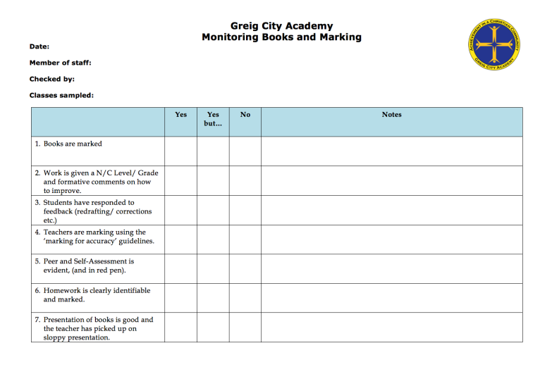
Notes:
This presentation by @TeacherToolkit ( Ross Morrison McGill ) is licensed under a Creative Commons Attribution-NonCommercial-NoDerivs 3.0 Unported License. Based on all work published at www.teachertoolkit.me.
Produced for PiXL National Conference – 3rd December 2013

Slide 79
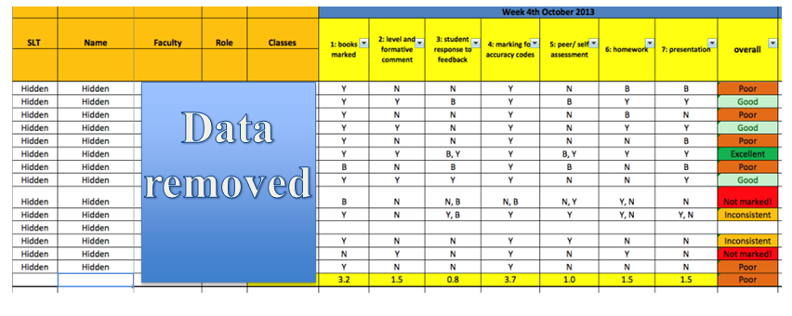
Book monitoring – Progress over time
Notes:
This presentation by @TeacherToolkit ( Ross Morrison McGill ) is licensed under a Creative Commons Attribution-NonCommercial-NoDerivs 3.0 Unported License. Based on all work published at www.teachertoolkit.me.
Produced for PiXL National Conference – 3rd December 2013

Slide 80
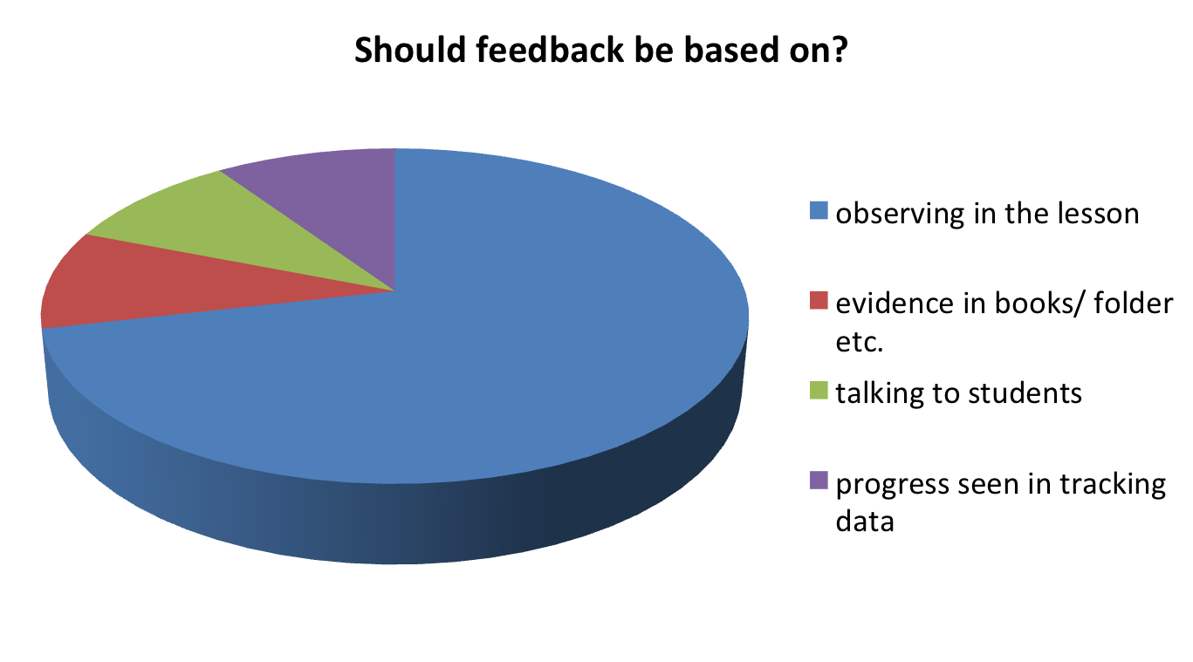
Questions we are asking
Notes:
This presentation by @TeacherToolkit ( Ross Morrison McGill ) is licensed under a Creative Commons Attribution-NonCommercial-NoDerivs 3.0 Unported License. Based on all work published at www.teachertoolkit.me.
Produced for PiXL National Conference – 3rd December 2013

Slide 81
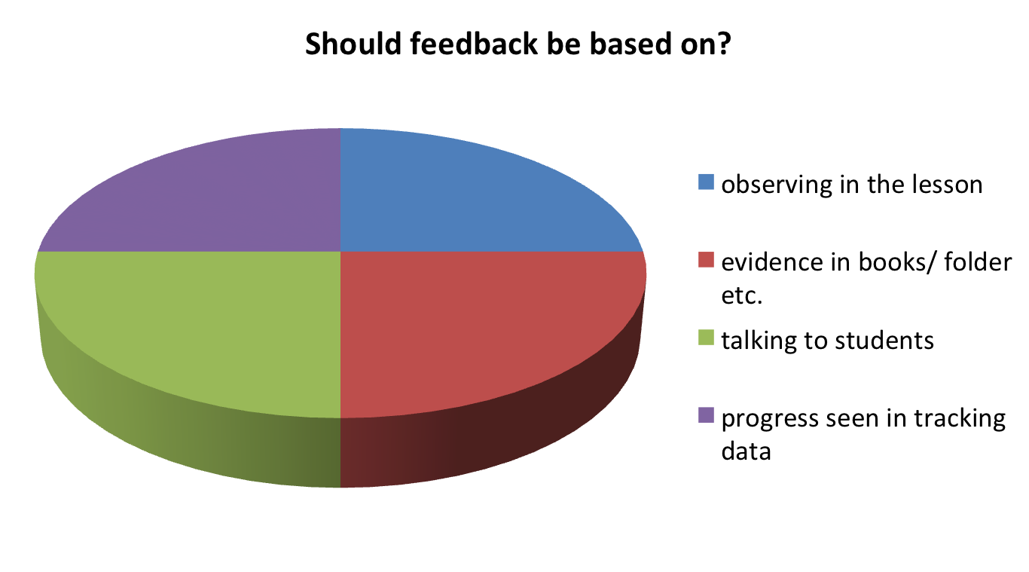
Questions we are solving
Notes:
This presentation by @TeacherToolkit ( Ross Morrison McGill ) is licensed under a Creative Commons Attribution-NonCommercial-NoDerivs 3.0 Unported License. Based on all work published at www.teachertoolkit.me.
Produced for PiXL National Conference – 3rd December 2013

Slide 82
Progress over time…
NOT 20 minute observation
Notes:
This presentation by @TeacherToolkit ( Ross Morrison McGill ) is licensed under a Creative Commons Attribution-NonCommercial-NoDerivs 3.0 Unported License. Based on all work published at www.teachertoolkit.me.
Produced for PiXL National Conference – 3rd December 2013

Slide 83
“There is no progress within lessons.
There is only learning.”
“The Ofsted framework talks about ‘gains in their knowledge, skills and understanding’ in lessons. They are things that inspectors will be looking to see from the students.
Where progress is mentioned, it is not something that inspectors will be looking to see from the students, because it is about the effectiveness of monitoring that they will be looking to see from the teachers.”
Keven Bartle @KevBartle
Notes:
This presentation by @TeacherToolkit ( Ross Morrison McGill ) is licensed under a Creative Commons Attribution-NonCommercial-NoDerivs 3.0 Unported License. Based on all work published at www.teachertoolkit.me.
Produced for PiXL National Conference – 3rd December 2013

Slide 84
What’s going to work?
Teamwork!
Notes:
Wonderpets- Linny; Tuck & Ming-Ming
This presentation by @TeacherToolkit ( Ross Morrison McGill ) is licensed under a Creative Commons Attribution-NonCommercial-NoDerivs 3.0 Unported License. Based on all work published at www.teachertoolkit.me.
Produced for PiXL National Conference – 3rd December 2013

Slide 85
Thank you…
Ross Morrison McGill
@TeacherToolkit
www.TeacherToolkit.me
More on Twitter/Blogging if needed >>
Notes:
This presentation by @TeacherToolkit ( Ross Morrison McGill ) is licensed under a Creative Commons Attribution-NonCommercial-NoDerivs 3.0 Unported License. Based on all work published at www.teachertoolkit.me.
Produced for PiXL National Conference – 3rd December 2013

Slide 86
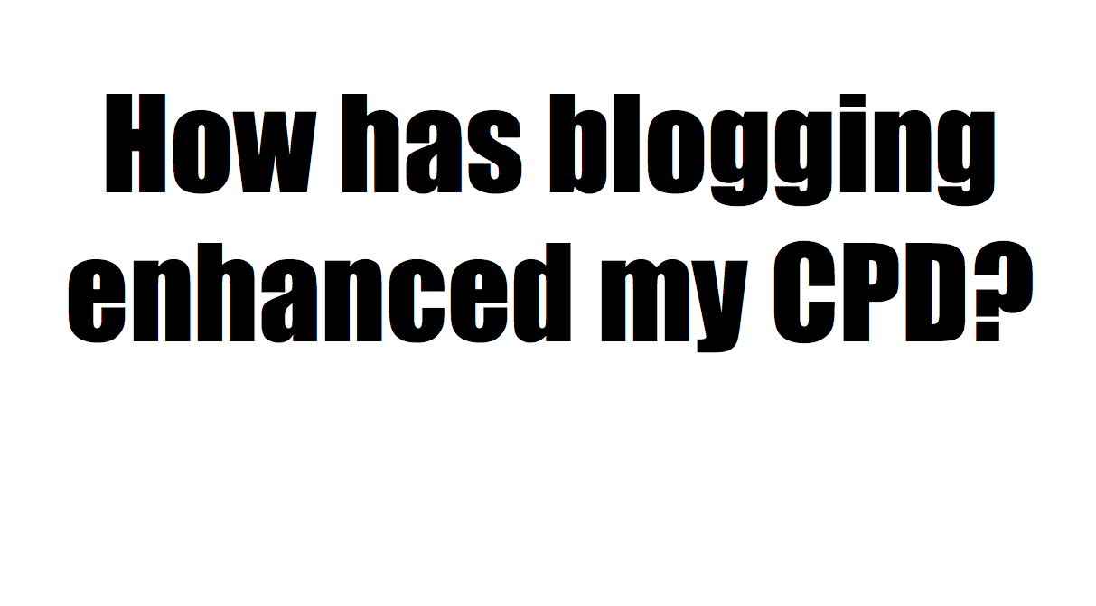
Notes:
This presentation by @TeacherToolkit ( Ross Morrison McGill ) is licensed under a Creative Commons Attribution-NonCommercial-NoDerivs 3.0 Unported License. Based on all work published at www.teachertoolkit.me.
Produced for PiXL National Conference – 3rd December 2013

Slide 87
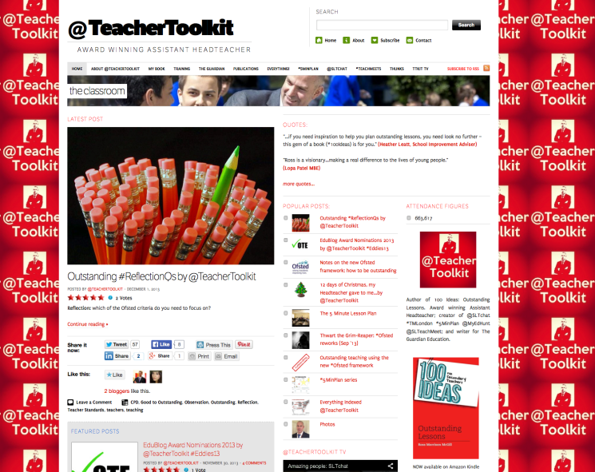
www.teachertoolkit.me
Notes:
This presentation by @TeacherToolkit ( Ross Morrison McGill ) is licensed under a Creative Commons Attribution-NonCommercial-NoDerivs 3.0 Unported License. Based on all work published at www.teachertoolkit.me.
Produced for PiXL National Conference – 3rd December 2013

Slide 88

Worldwide readership!
Notes:
This presentation by @TeacherToolkit ( Ross Morrison McGill ) is licensed under a Creative Commons Attribution-NonCommercial-NoDerivs 3.0 Unported License. Based on all work published at www.teachertoolkit.me.
Produced for PiXL National Conference – 3rd December 2013

Slide 89

@SLTchat
8000 followers
20 hosts
Trending
Notes:
This presentation by @TeacherToolkit ( Ross Morrison McGill ) is licensed under a Creative Commons Attribution-NonCommercial-NoDerivs 3.0 Unported License. Based on all work published at www.teachertoolkit.me.
Produced for PiXL National Conference – 3rd December 2013

Slide 90


@SLTchat by DfE
Notes:
This presentation by @TeacherToolkit ( Ross Morrison McGill ) is licensed under a Creative Commons Attribution-NonCommercial-NoDerivs 3.0 Unported License. Based on all work published at www.teachertoolkit.me.
Produced for PiXL National Conference – 3rd December 2013

Slide 91
Thank you…
Ross Morrison McGill
@TeacherToolkit
www.TeacherToolkit.me
Notes:
This presentation by @TeacherToolkit ( Ross Morrison McGill ) is licensed under a Creative Commons Attribution-NonCommercial-NoDerivs 3.0 Unported License. Based on all work published at www.teachertoolkit.me.
Produced for PiXL National Conference – 3rd December 2013

